Slide 1

Food-Energy-Water (Energy-Water-Land) Systems Zarrar Khan Joint Global Change Research Institute
PLCY-798K
Integrated Human-Earth System Modeling and Policy Assessment
March 1, 2023

Slide 2
Today’s Topics
Motivation
Nexus interactions in IAMs
Common Interconnections we model:
Socioeconomics Drivers
Energy-Water Nexus
Water-Land-Food Nexus
Climate Impacts on Energy, Water, Land Nexus
Example Case Studies

Slide 3
Motivation

Slide 4

Motivation – Everything is connected
1960s - Edward Lorenz, Meteorology professor MIT (Chaos Theory)
Running a computer program to test various weather simulations and he (Lorenz) discovered that rounding off one variable from .506127 to .506 dramatically changed the two months of weather predictions in his simulation.
"The 'innumerable' interconnections of nature, Lorenz noted, mean a butterfly's flap could cause a tornado — or, for all we know, could prevent one. Similarly, should we make even a tiny alteration to nature, 'we shall never know what would have happened if we had not disturbed it,' since subsequent changes are too complex and entangled to restore a previous state.”
Peter Dizikes - Boston Globe - 2008
Butterfly Effect – Lorenz Attractor simulation
https://science.howstuffworks.com/math-concepts/butterfly-effect.htm

Slide 5
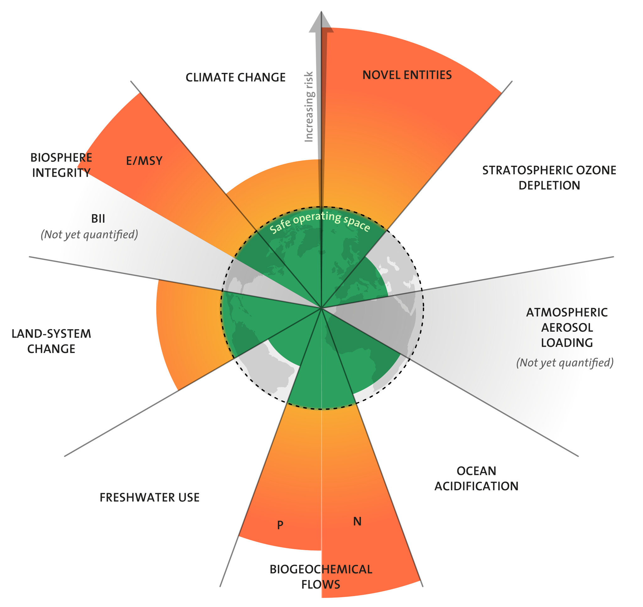
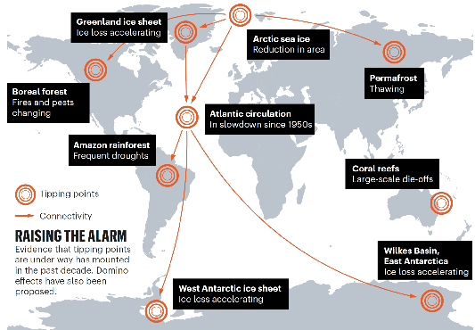
Motivation – Limits & Tipping Points
Planetary Boundaries
Tipping Points
Stockholm Resilience Centre, based on analysis in Persson et al 2022 and Steffen et al 2015
https://www.stockholmresilience.org/research/planetary-boundaries.html
Figure 1. Climate tipping elements that could cross this century due to human activities (from Lenton et. al., 2019, Nature)

Slide 6
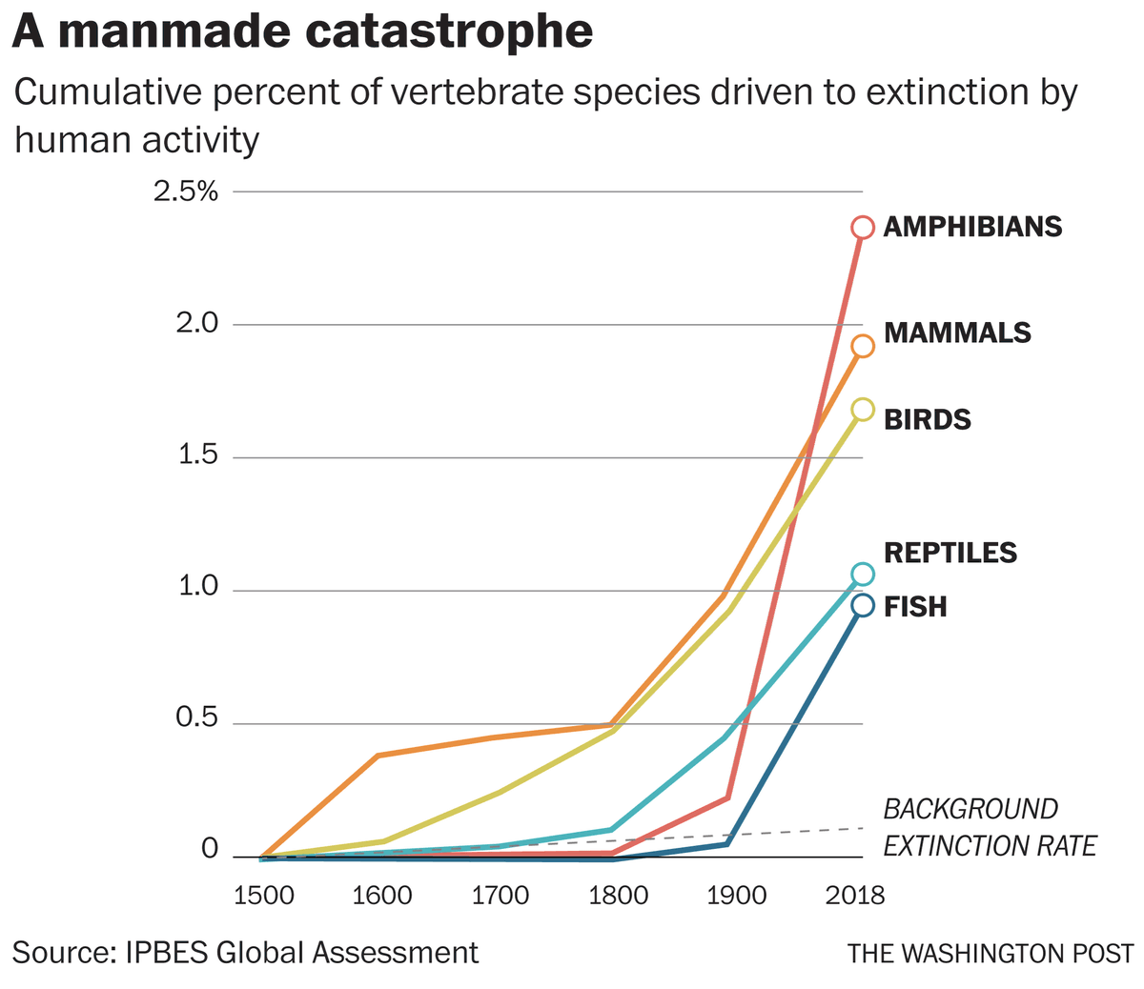
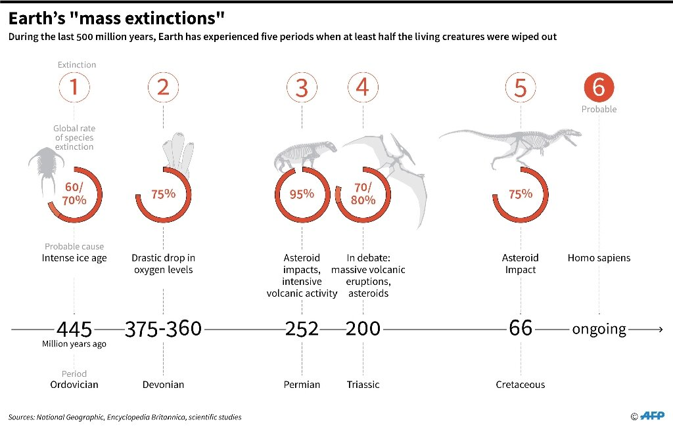
Motivation – Collapse of Systems
https://phys.org/news/2019-04-earth-major-mass-extinctions.html
https://www.washingtonpost.com/business/2019/08/16/scientists-decry-ignorance-rolling-back-species-protections-midst-mass-extinction/

Slide 7
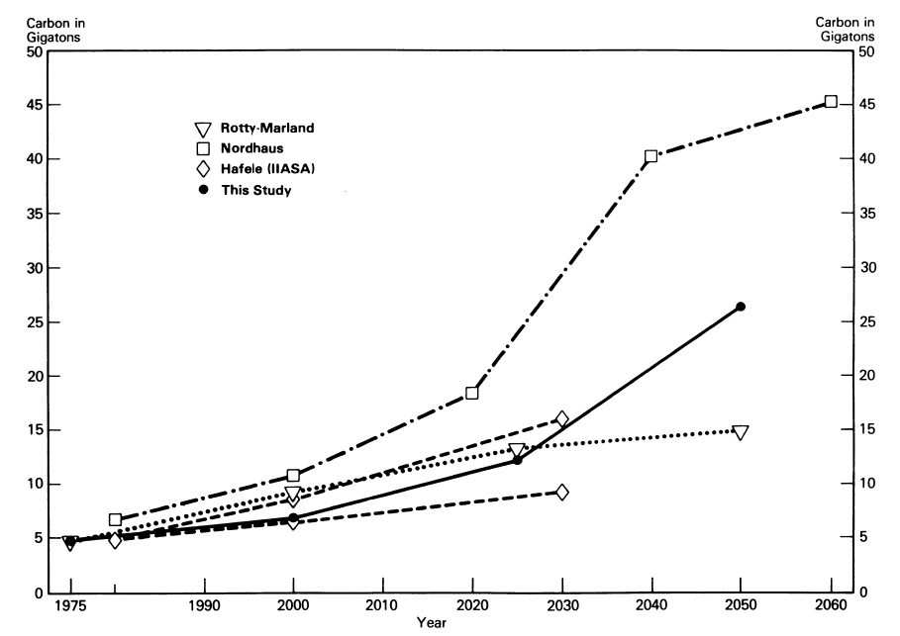
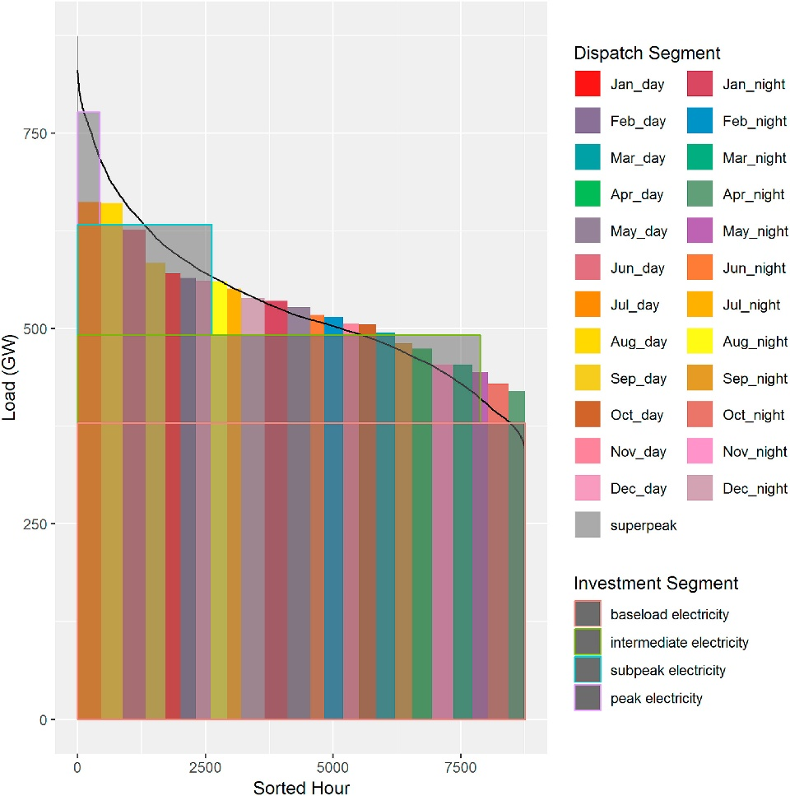
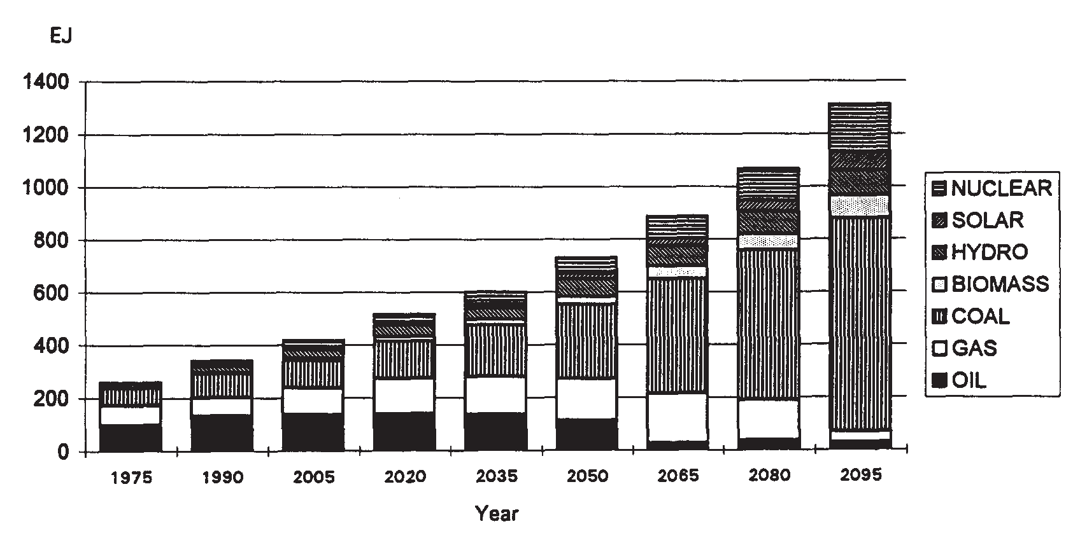
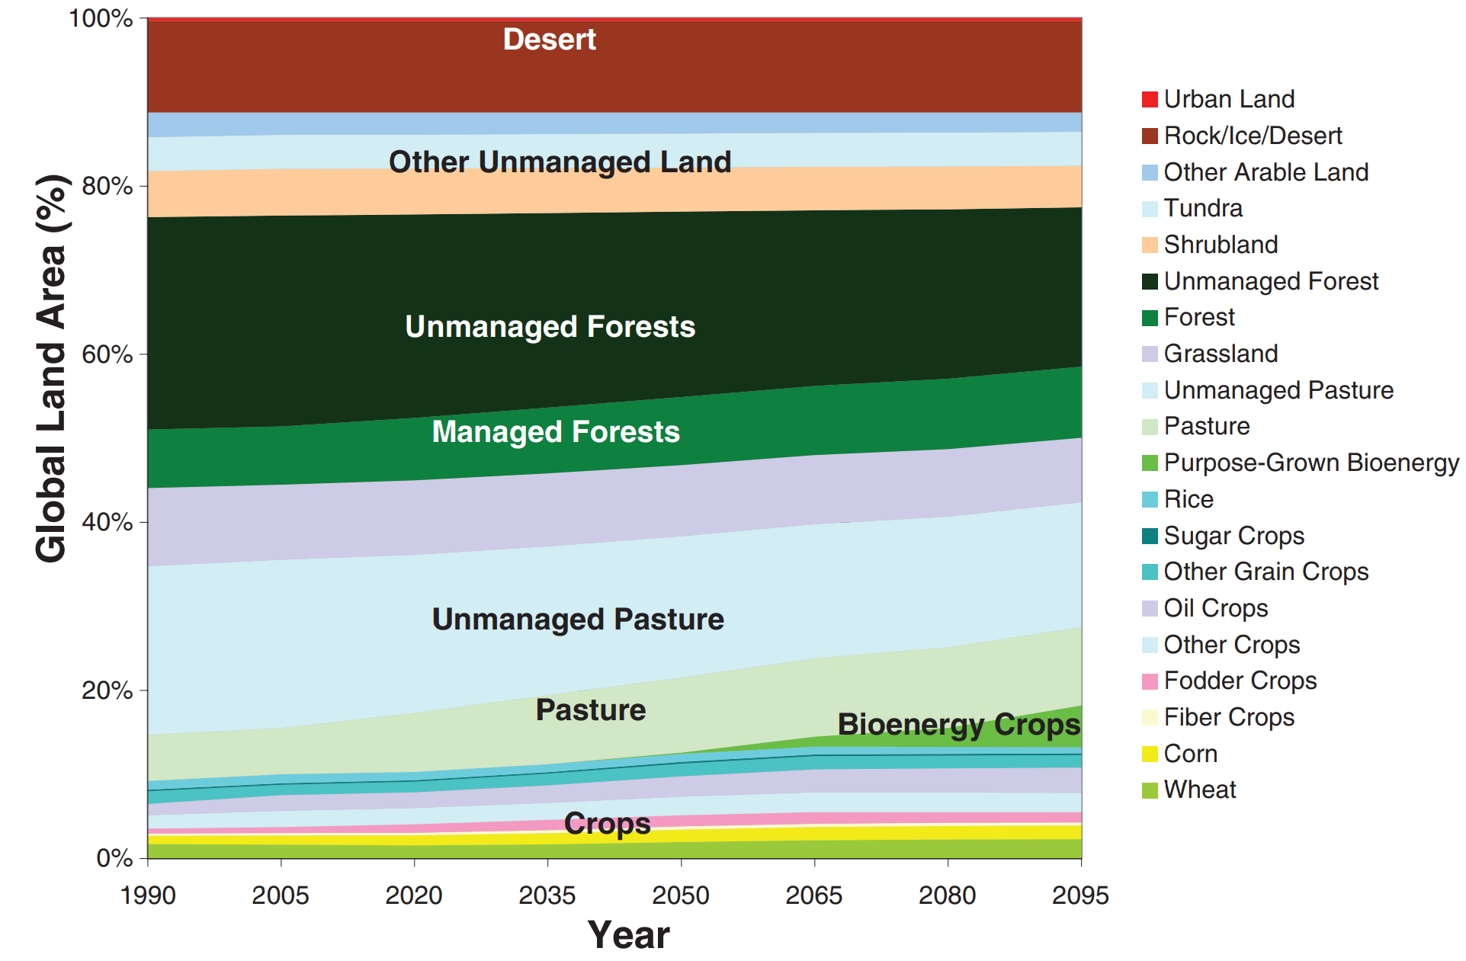
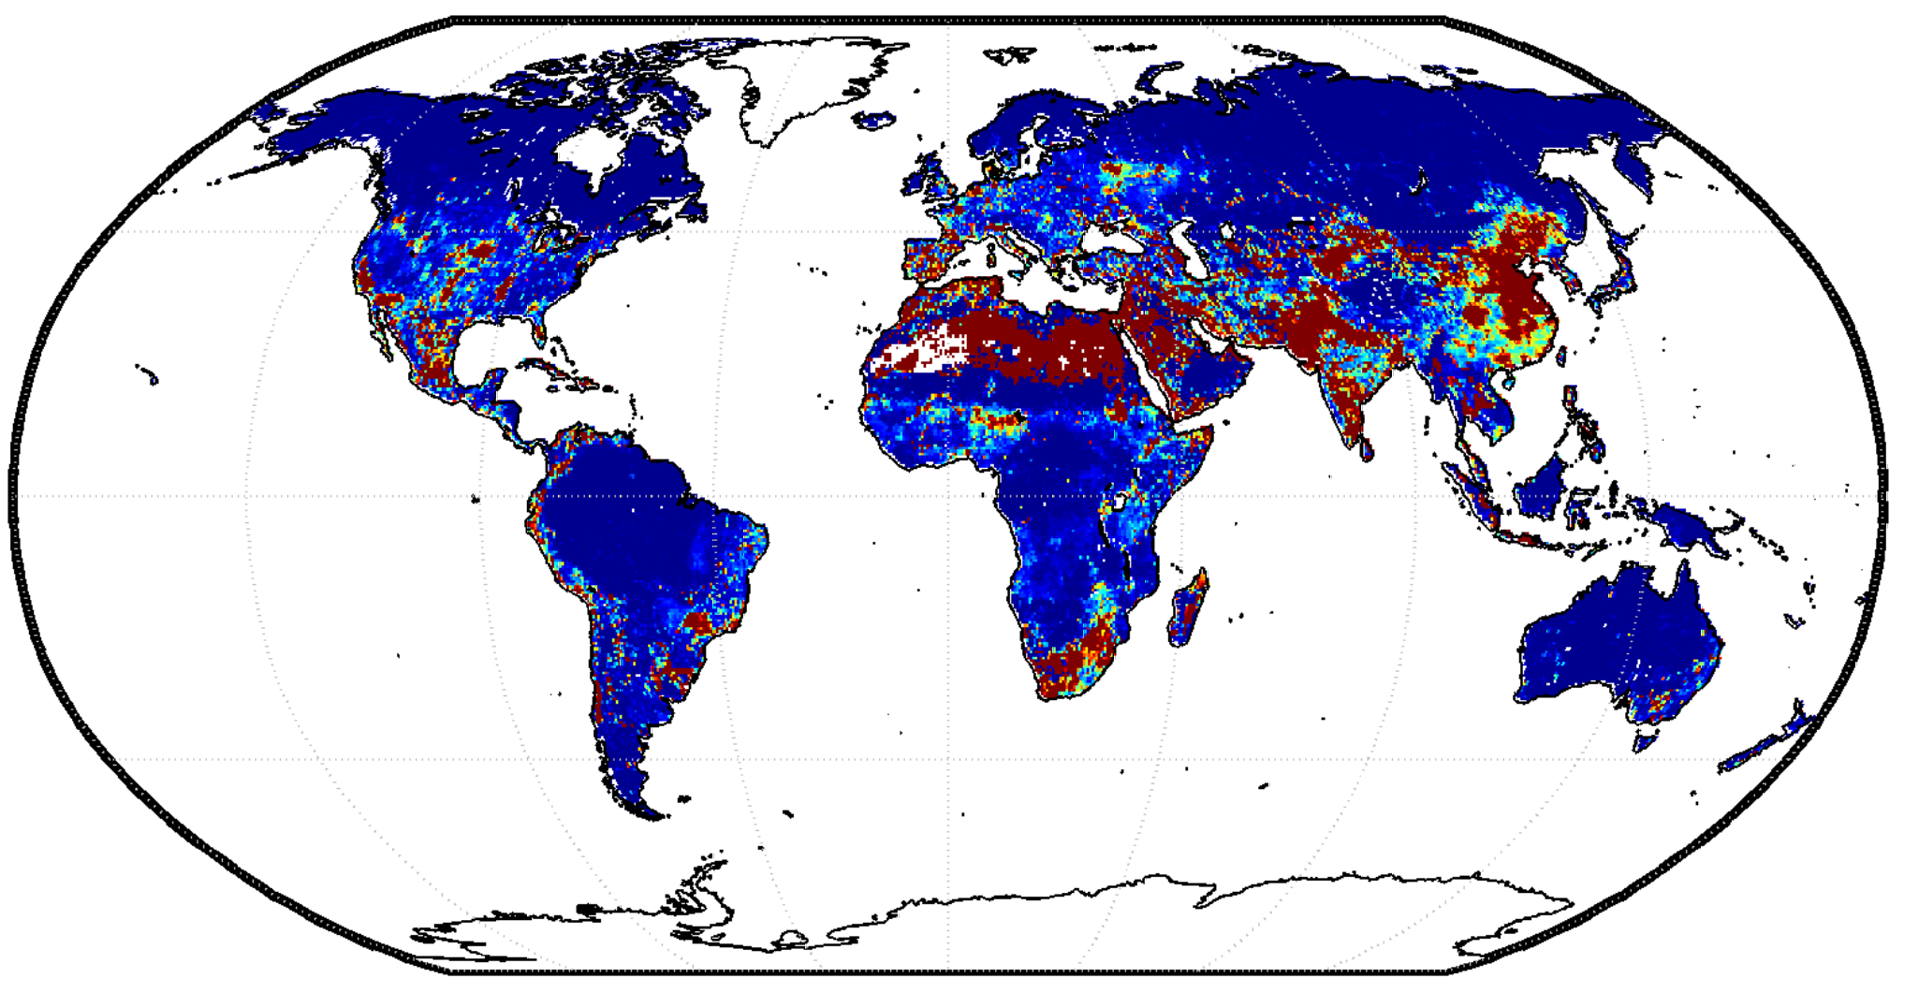
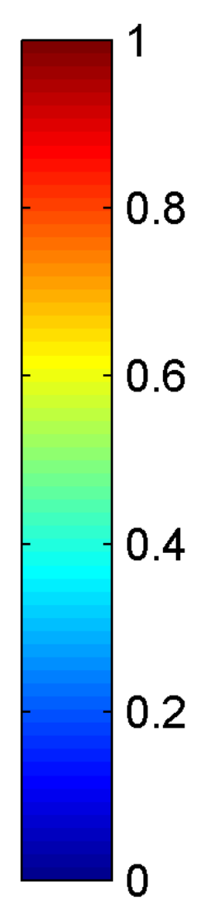
The Evolution of GCAM Research
1980s
Projections of emissions and concentrations
Understanding the complex interactions among energy, water, land, climate, socioeconomics, and other important human and natural systems at regional to global scales
2015–Present
Integrating impacts
Edmonds and Reilly (1983). The Energy Journal.
Wise et al. (2019). ESR.
1990s
2010s
Energy and Technology
2000s
Water system
Land use system
Water Scarcity Index
Edmonds et al. (1995).
Energy Policy.
Wise et al. (2009).
Science.
Hejazi et al. (2014). HESS.
ENERGY-ECONOMY-CLIMATE
ENERGY-ECONOMY-LAND-CLIMATE
ENERGY-ECONOMY-LAND-WATER-CLIMATE

Slide 8
Nexus interactions in IAMs

Slide 9
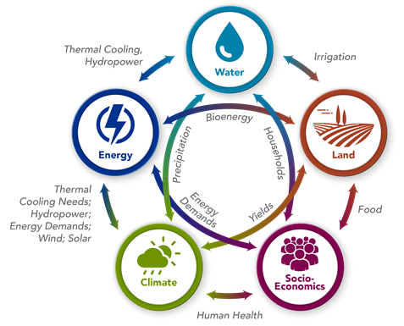
What important “nexus” interactions exist in reality? Do they all appear in IAMs?

Slide 10
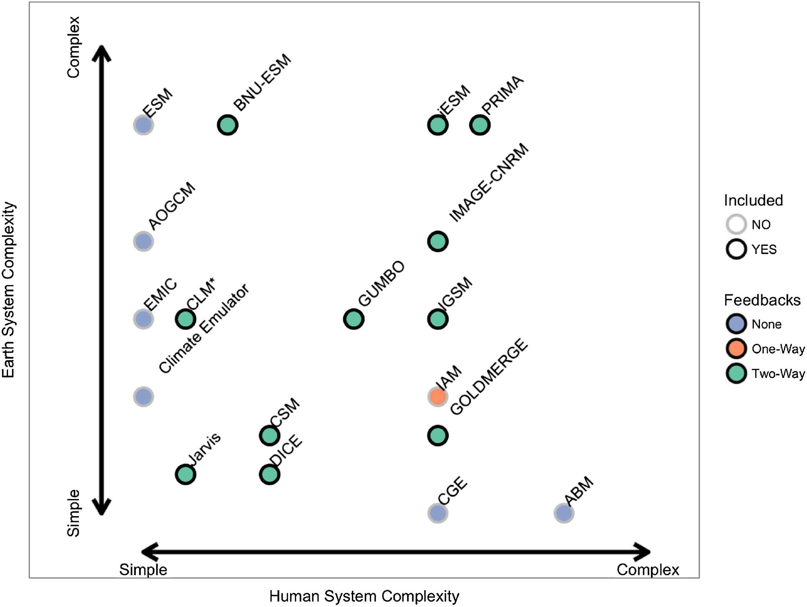
IAMs do not typically account for two-way feedbacks. Instead, we feed climate impacts on water supply one-way.
Calvin and Bond Lamberty (2018), ERL

Slide 11
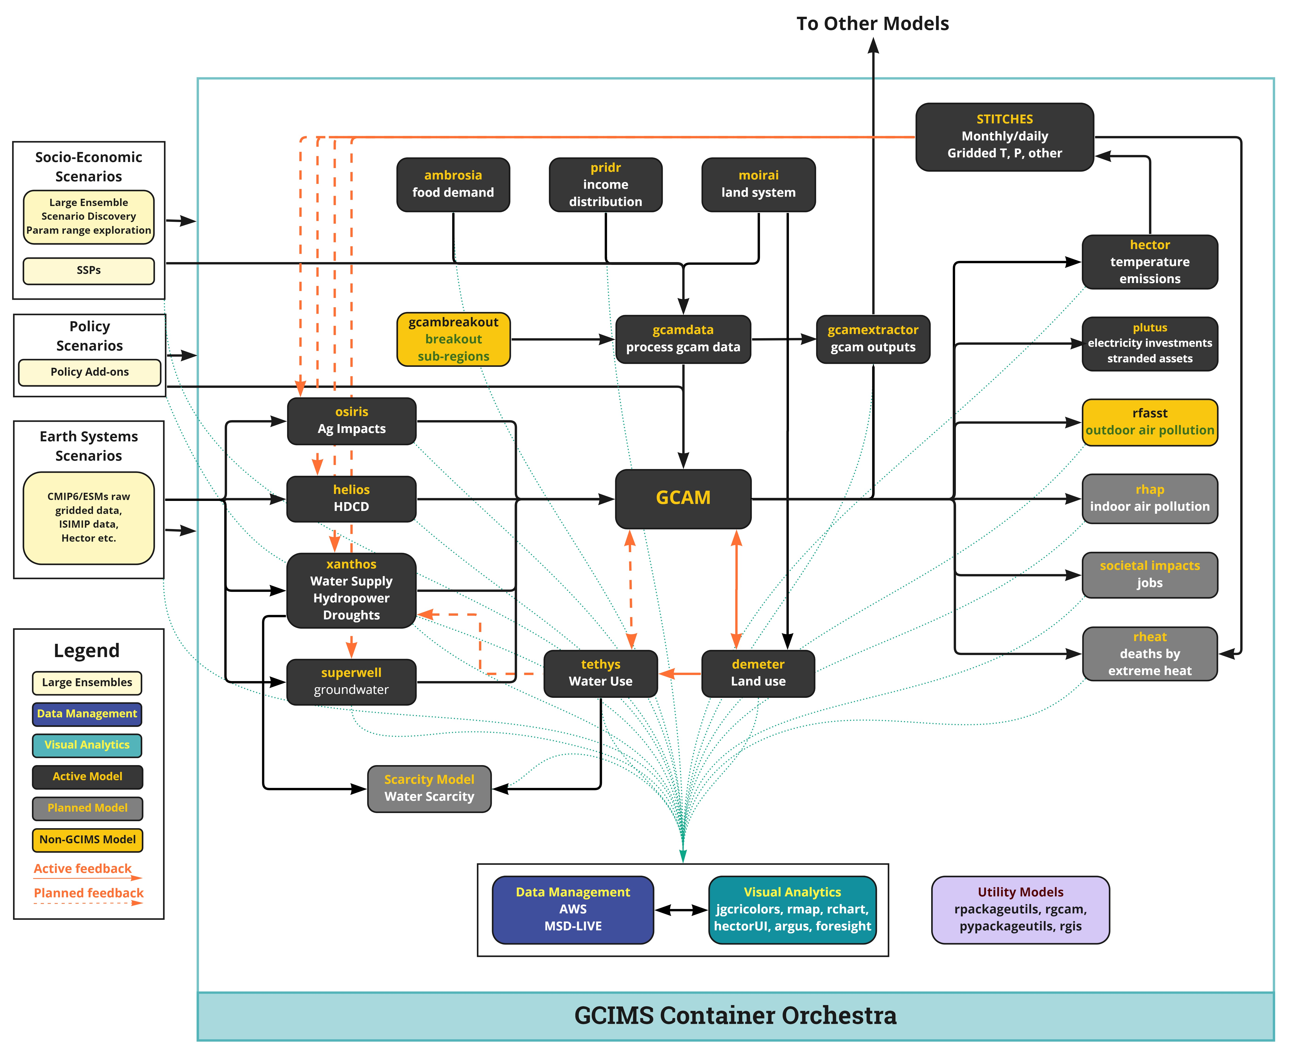
IAM Interconnections in GCIMS
Several endogenous GCAM feedbacks
Several one-way feedbacks with exogenous models
Time-step by time-step feedback under development
https://jgcri.github.io/gcims_integration/software.html

Slide 12
Common Interconnections we model: Socioeconomics

Slide 13
Socioeconomic Nexus
How will socioeconomics interact with other factors? IAMs have traditionally been weak on representing these feedbacks.
Exogenous drivers (GDP, Pop) of demand and consumption
Feedback on health, mortality, diets, behaviour, migration, heating and cooling

Slide 14
Common Interconnections we model: Energy – Water nexus

Slide 15
Energy-Water Nexus
How much energy is used for water, and vice versa?

Slide 16
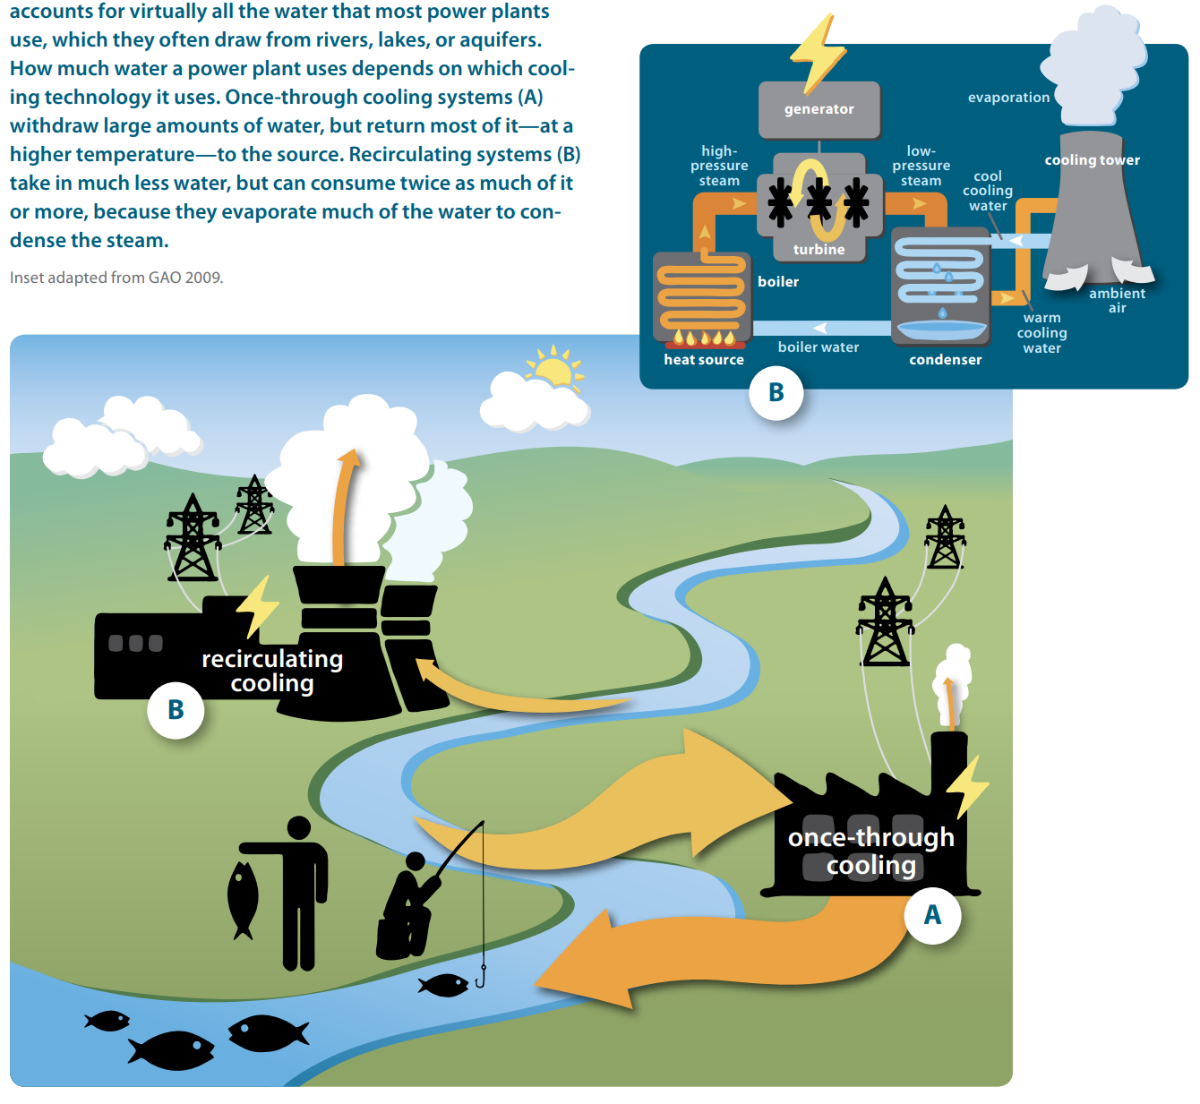
Thermoelectric power plants require cooling
Once-through cooling technology requires a lot of water “withdrawal”, with some “consumption”
Recirculating cooling technology requires much less water “withdrawal”, but high “consumption”
Source: Averyt et al. (2011)

Slide 17
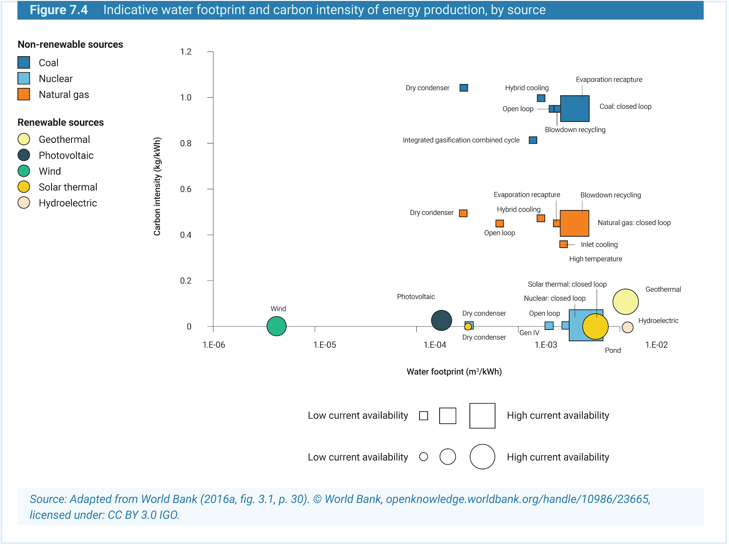
Water for Energy
Some renewables, like wind and solar, have low carbon intensity and low water footprints
Gas and coal have similar water footprints, but gas has lower carbon intensity

Slide 18
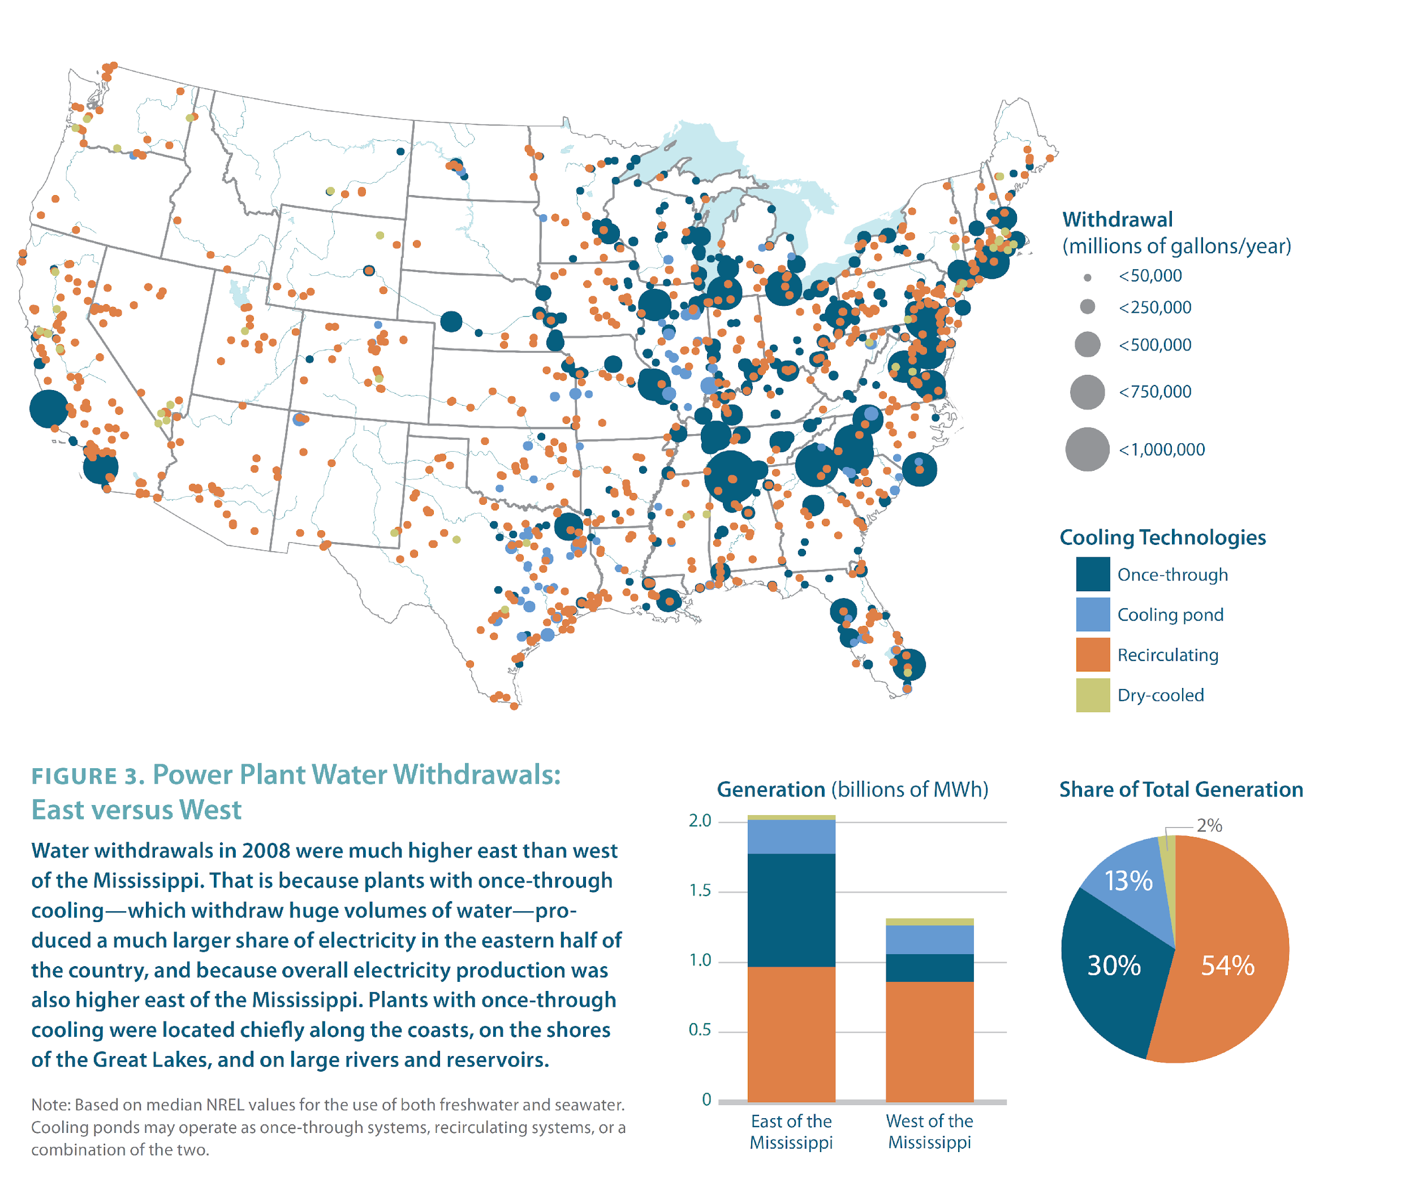
Dramatic Differences Between Eastern and Western U.S.
Source: Averyt et al. (2011)

Slide 19
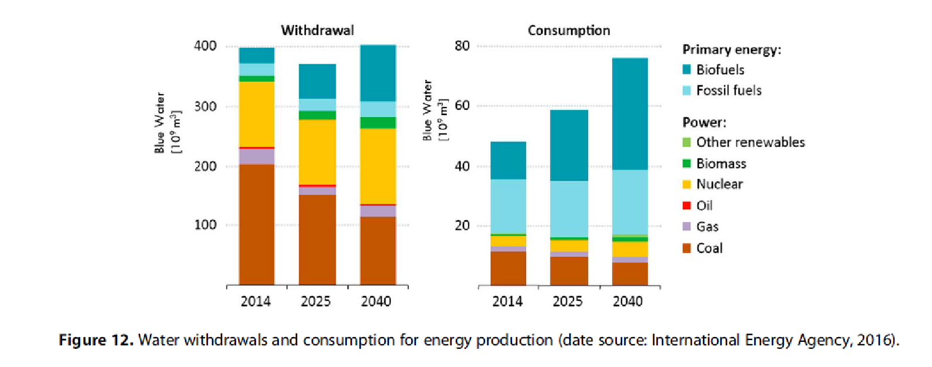
Water for Energy
D’Odorico et al. (2018), Geophysical Research Letters

Slide 20
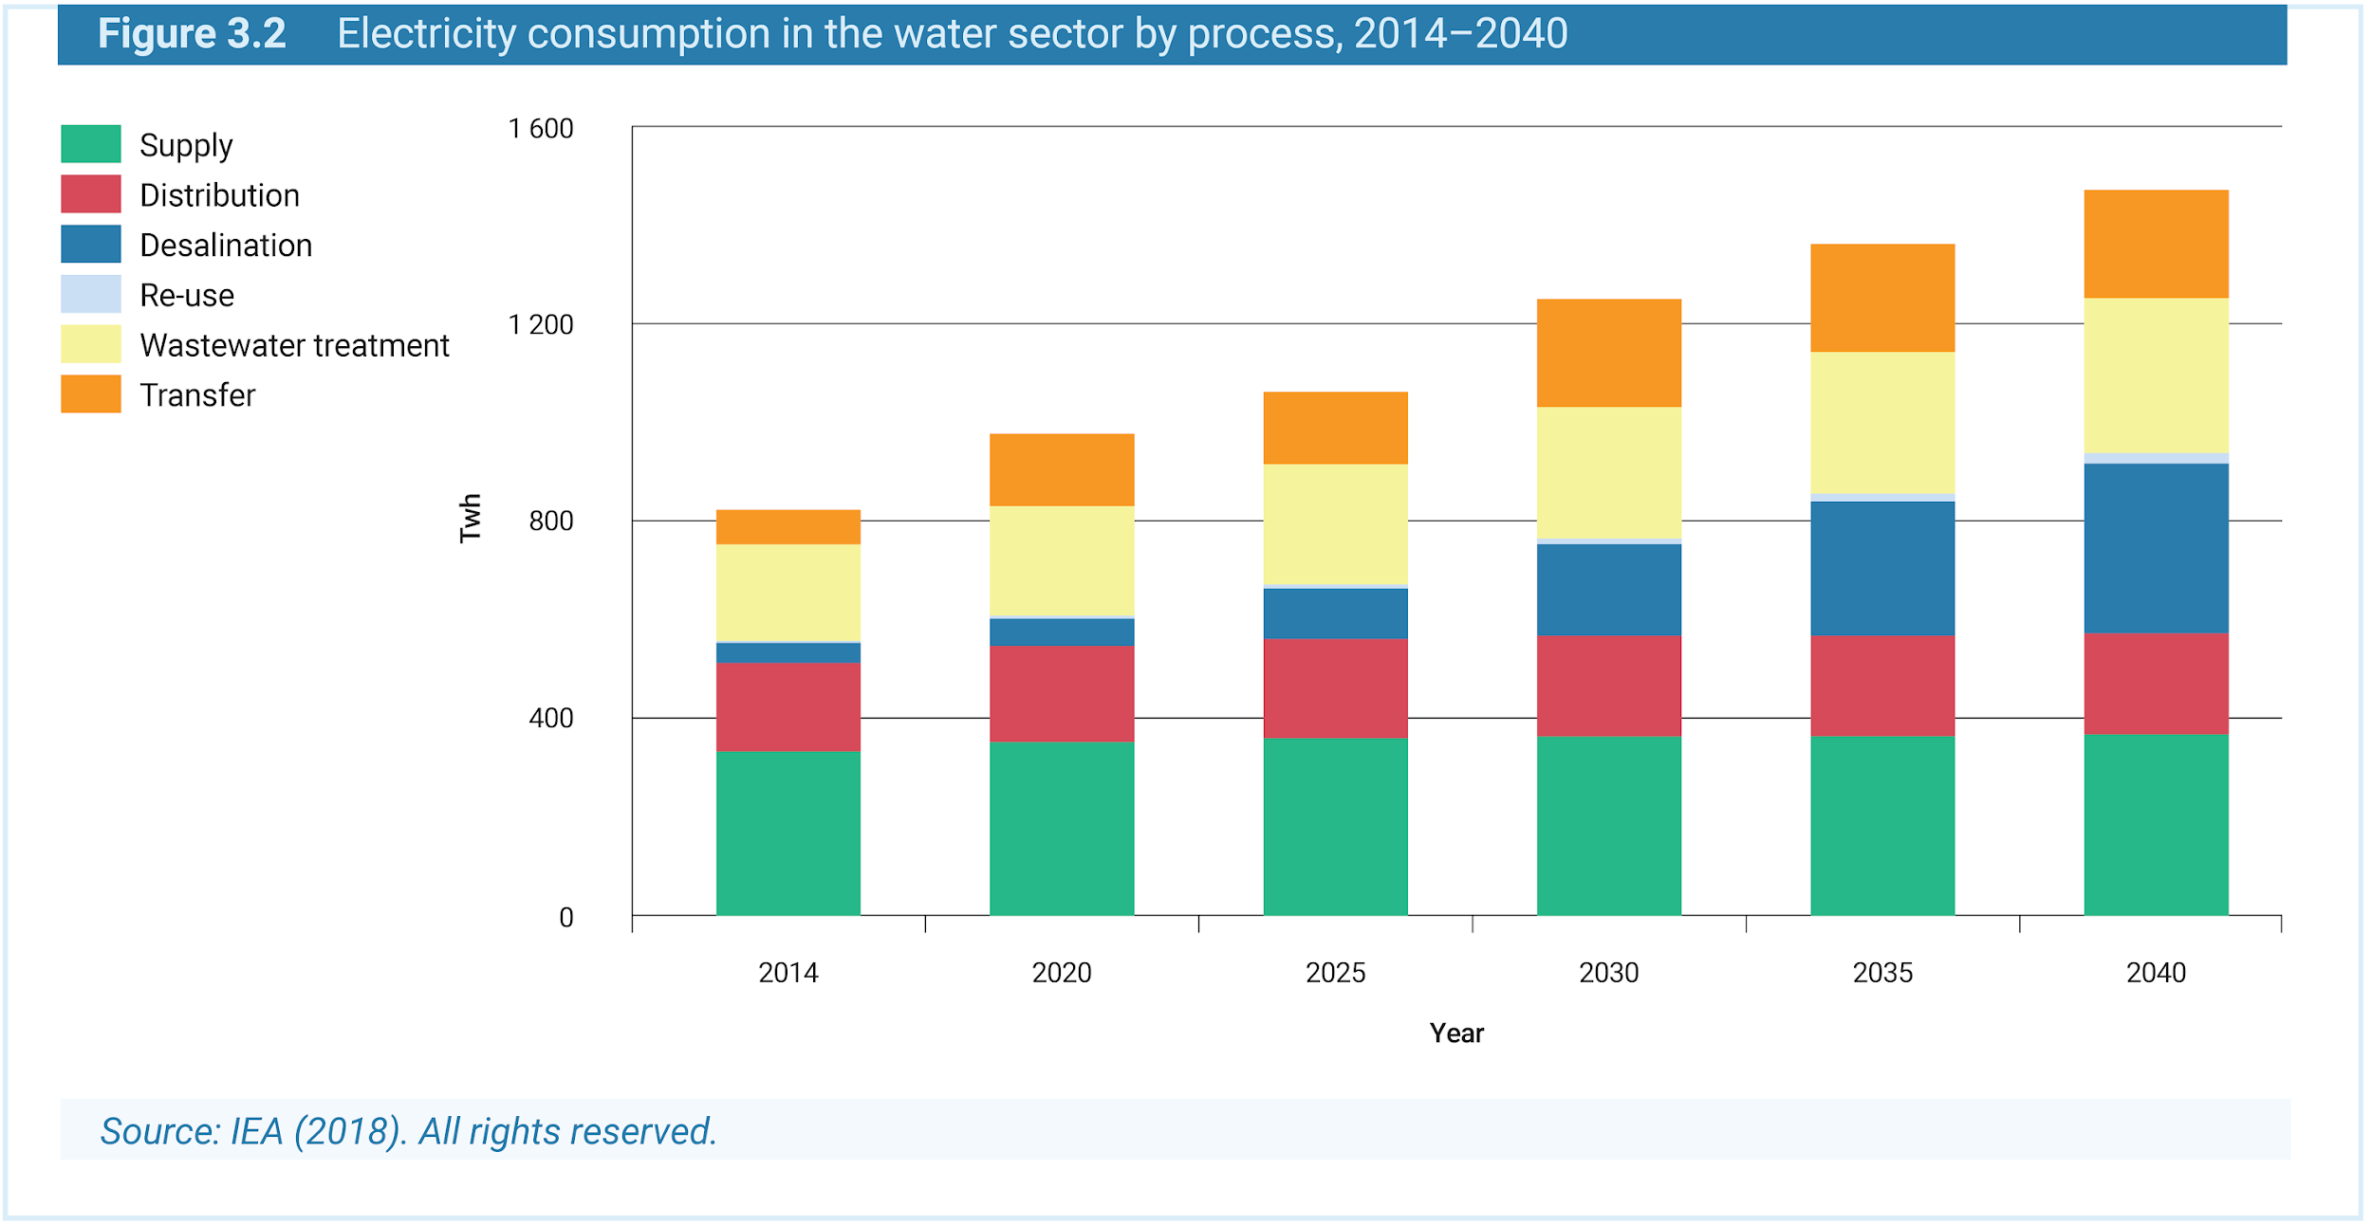
Energy for Water

Slide 21
Common Interconnections we model: Water – Land – Food Nexus

Slide 22
Water-Land-Food Nexus
How much water is used to produce crops and food from land?

Slide 23
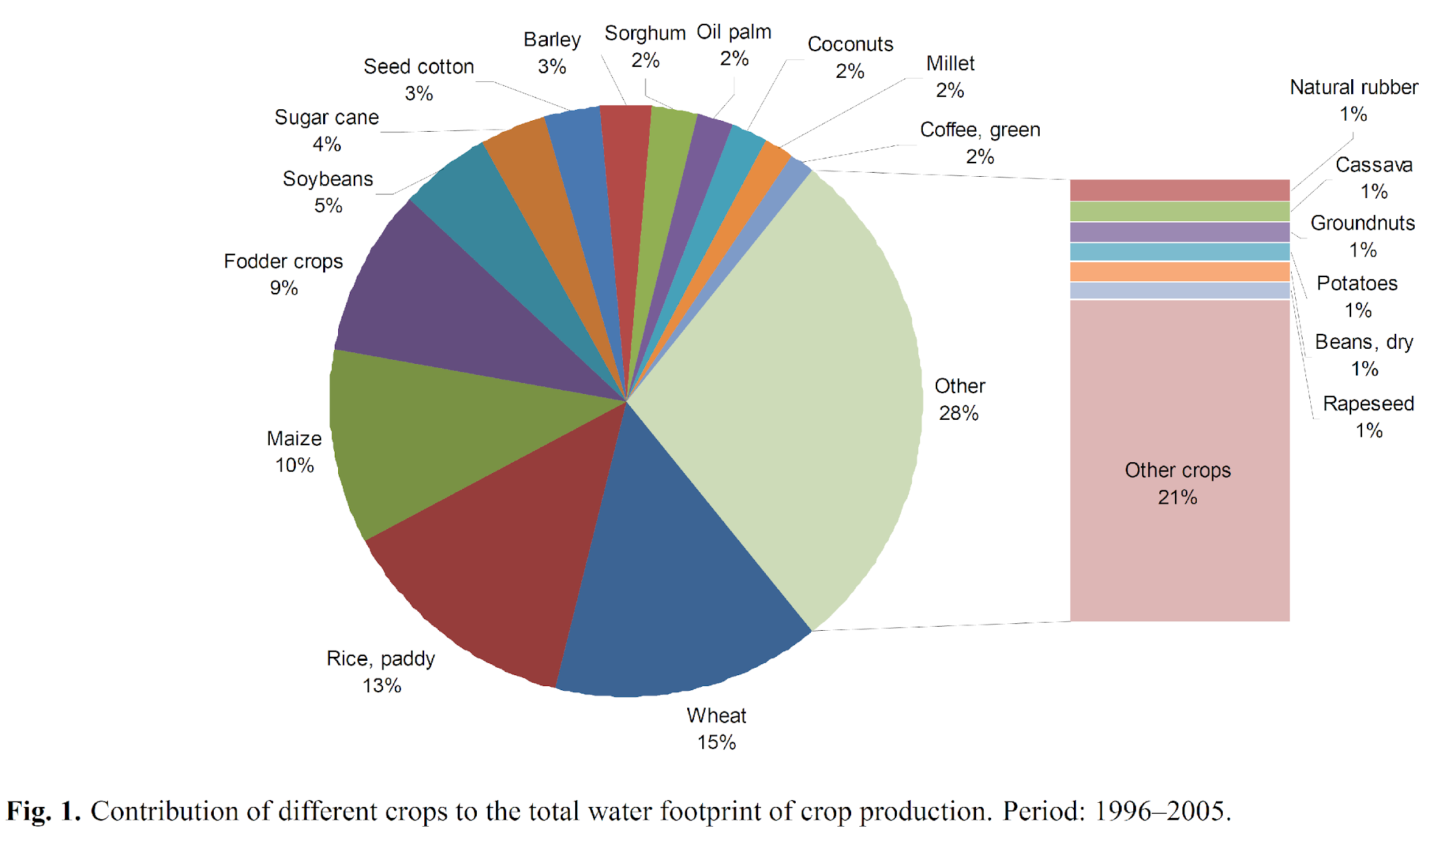
Share of total global water usage by crop
Source: Mekonnen and Hoekstra (2011), HESS

Slide 24
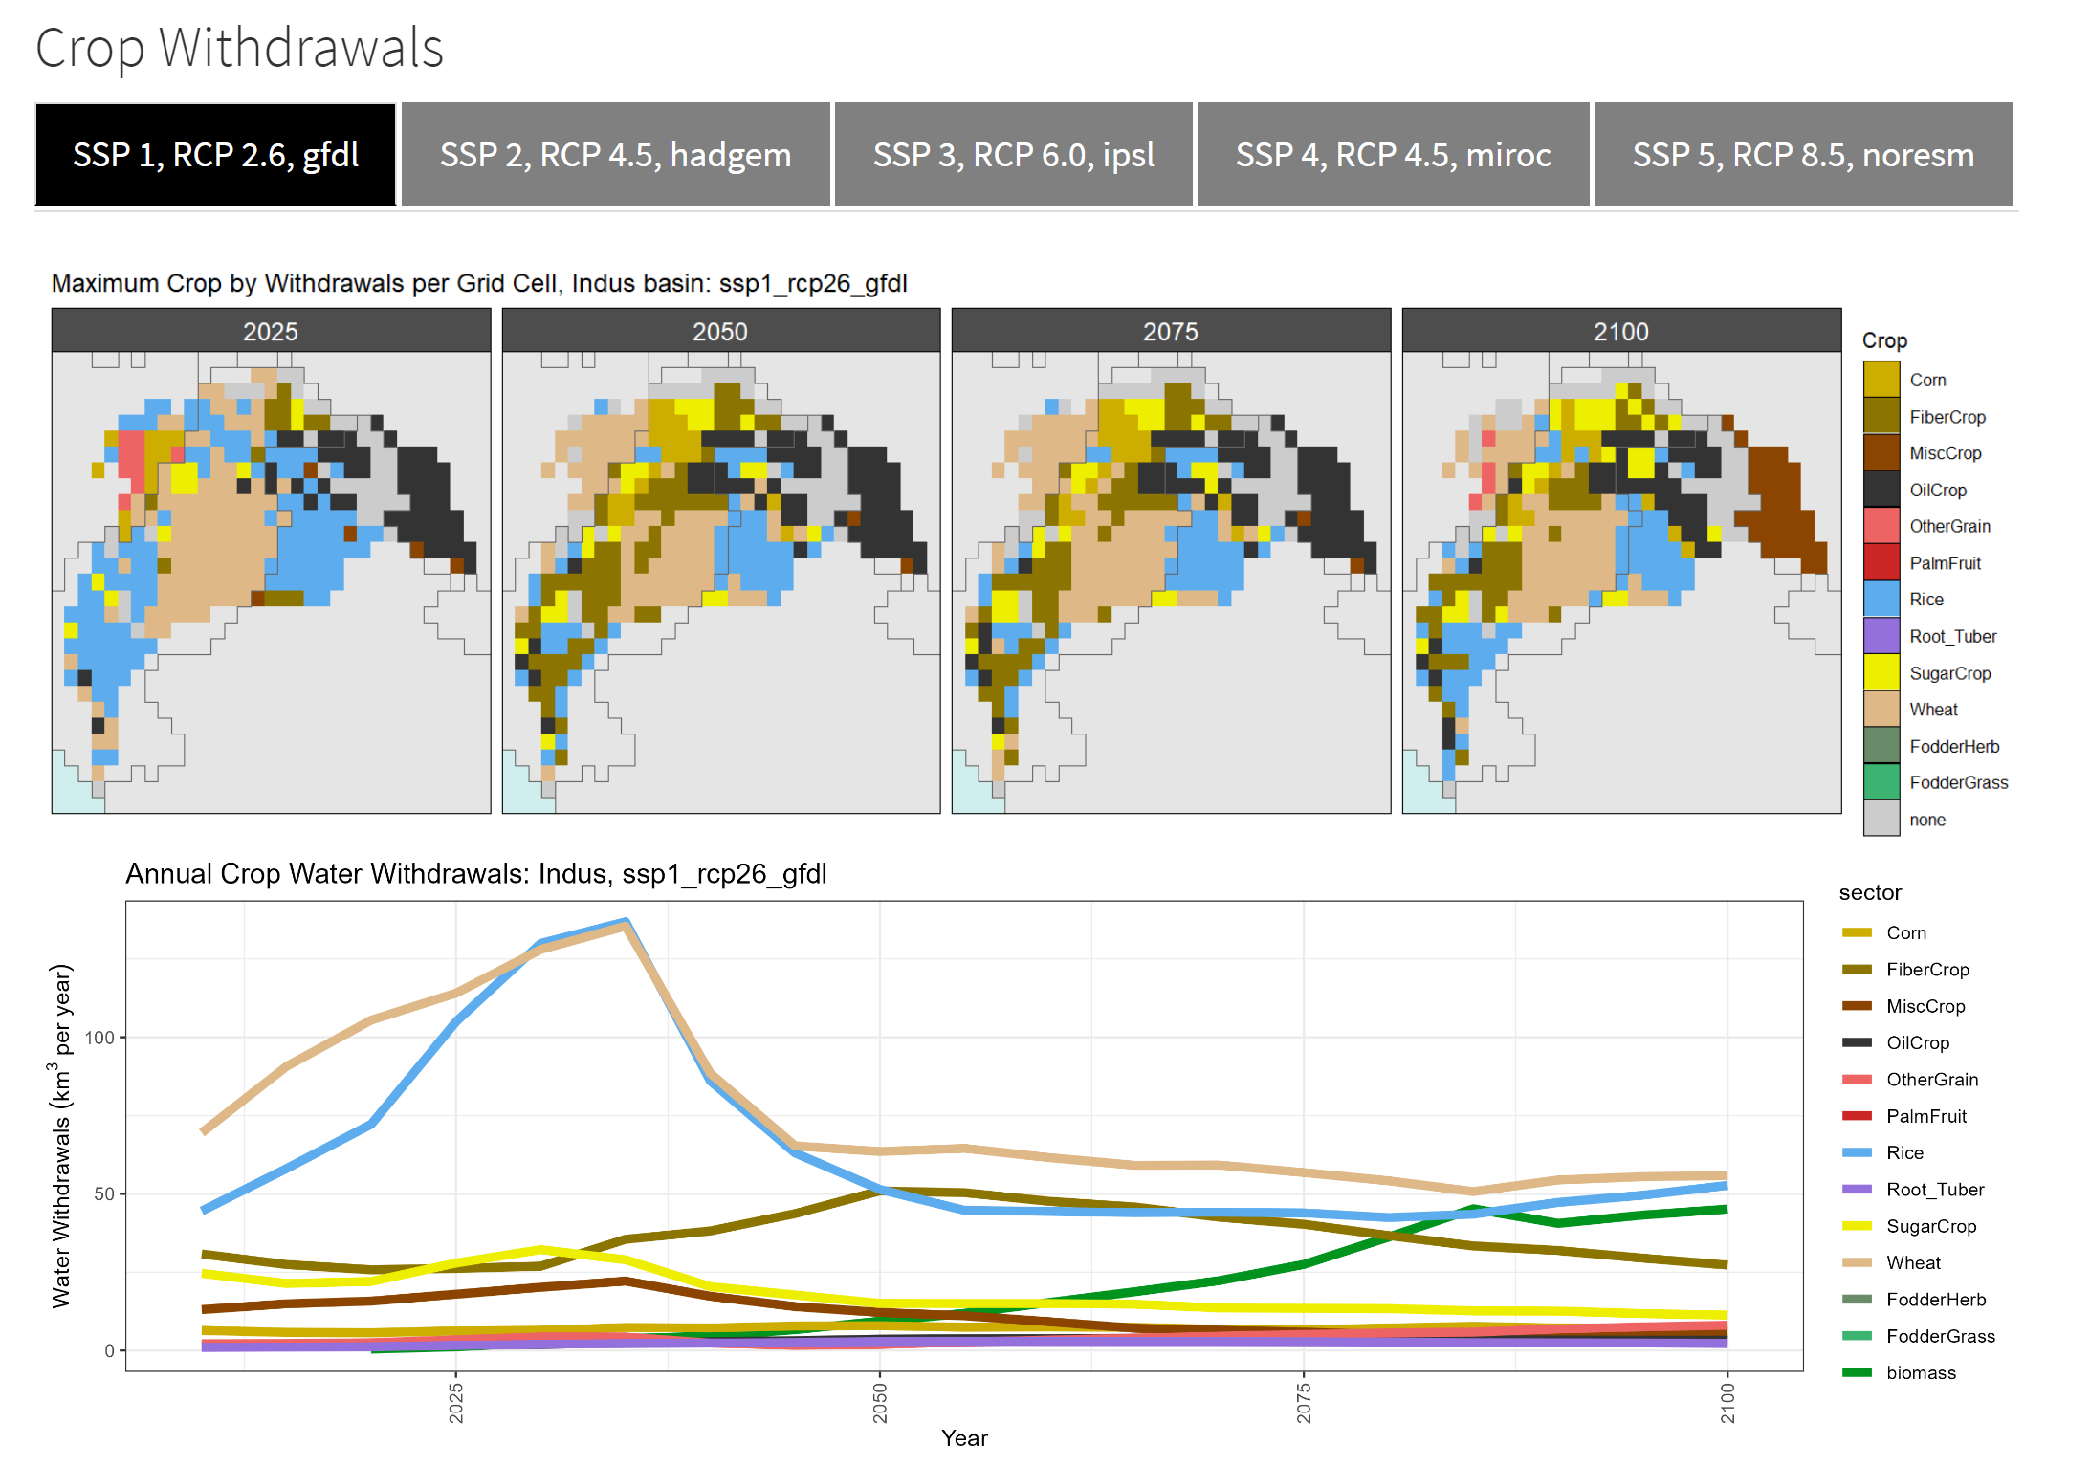
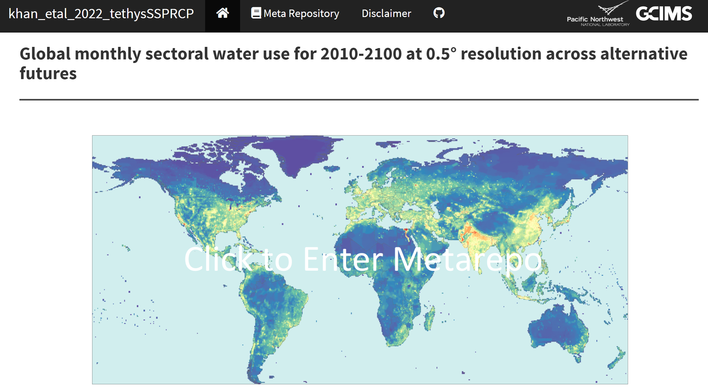
Gridded Water withdrawals and consumption
https://jgcri.github.io/khan-etal_2022_tethysSSPRCP/index.html

Slide 25
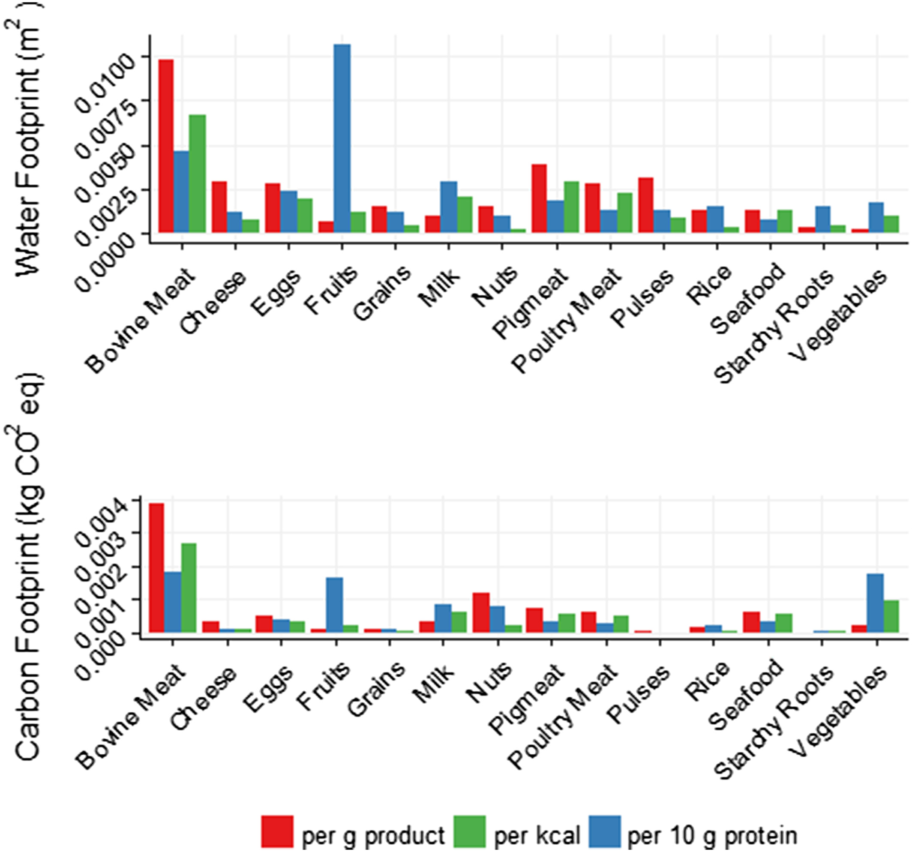
Water & Carbon Implications of Food
Figure 2B: The water and carbon footprints of food products (based on Gephart, Davis, et al., 2016). (Source: d’Odorico et al. (2018), Geophysical Research Letters)

Slide 26
Common Interconnections we model: Climate Impacts on Energy, Water, Land Nexus

Slide 27
Climate-Energy,Water,Land Nexus
Energy and land usage impact climate change, that water is a constraint on energy and land development. But how does climate in turn impact energy, water, and land systems?

Slide 28



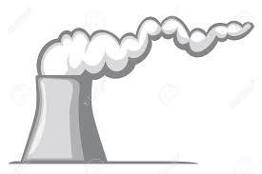


Climate Change Impacts Across Multiple Sectors
Energy Demand
Increases in electricity demand, decreases in natural gas demand
Hydropower
Changes in production of hydropower
Thermal Power
Decreases in thermal power production
Agriculture
Changes in productivity of land, bioenergy supply, crop production, carbon sequestration
Water Supply
Changes in water availability (globally and regionally)
33

Slide 29
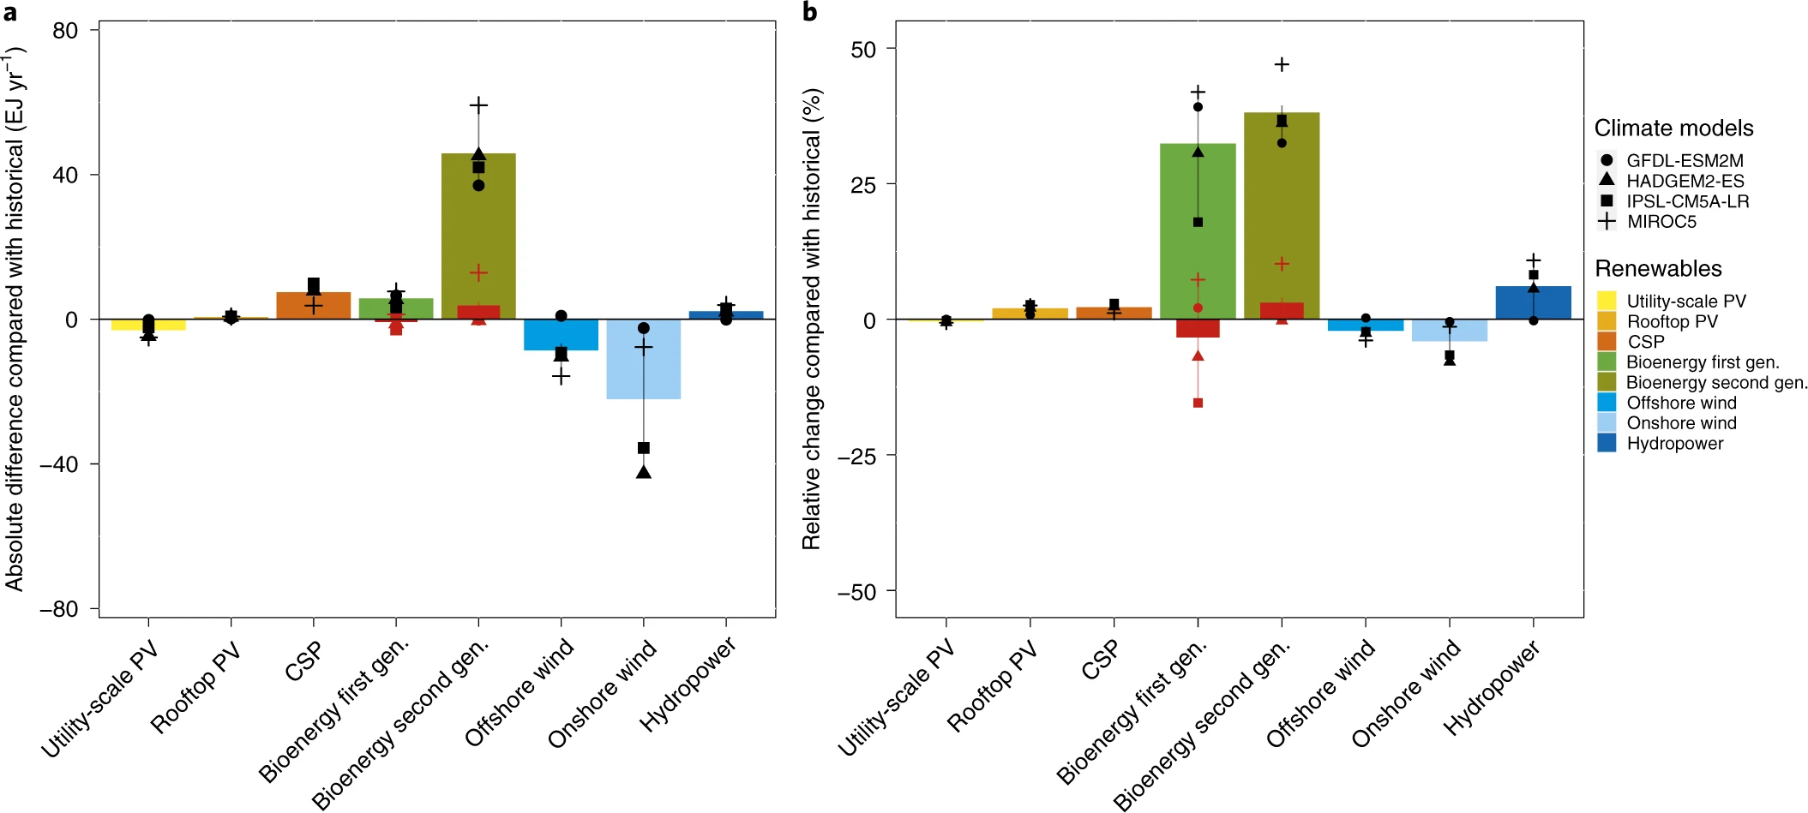
Climate Change Impacts on Renewable Energy Supply
Source: Gernaat et al. (2021), Nature Climate Change

Slide 30
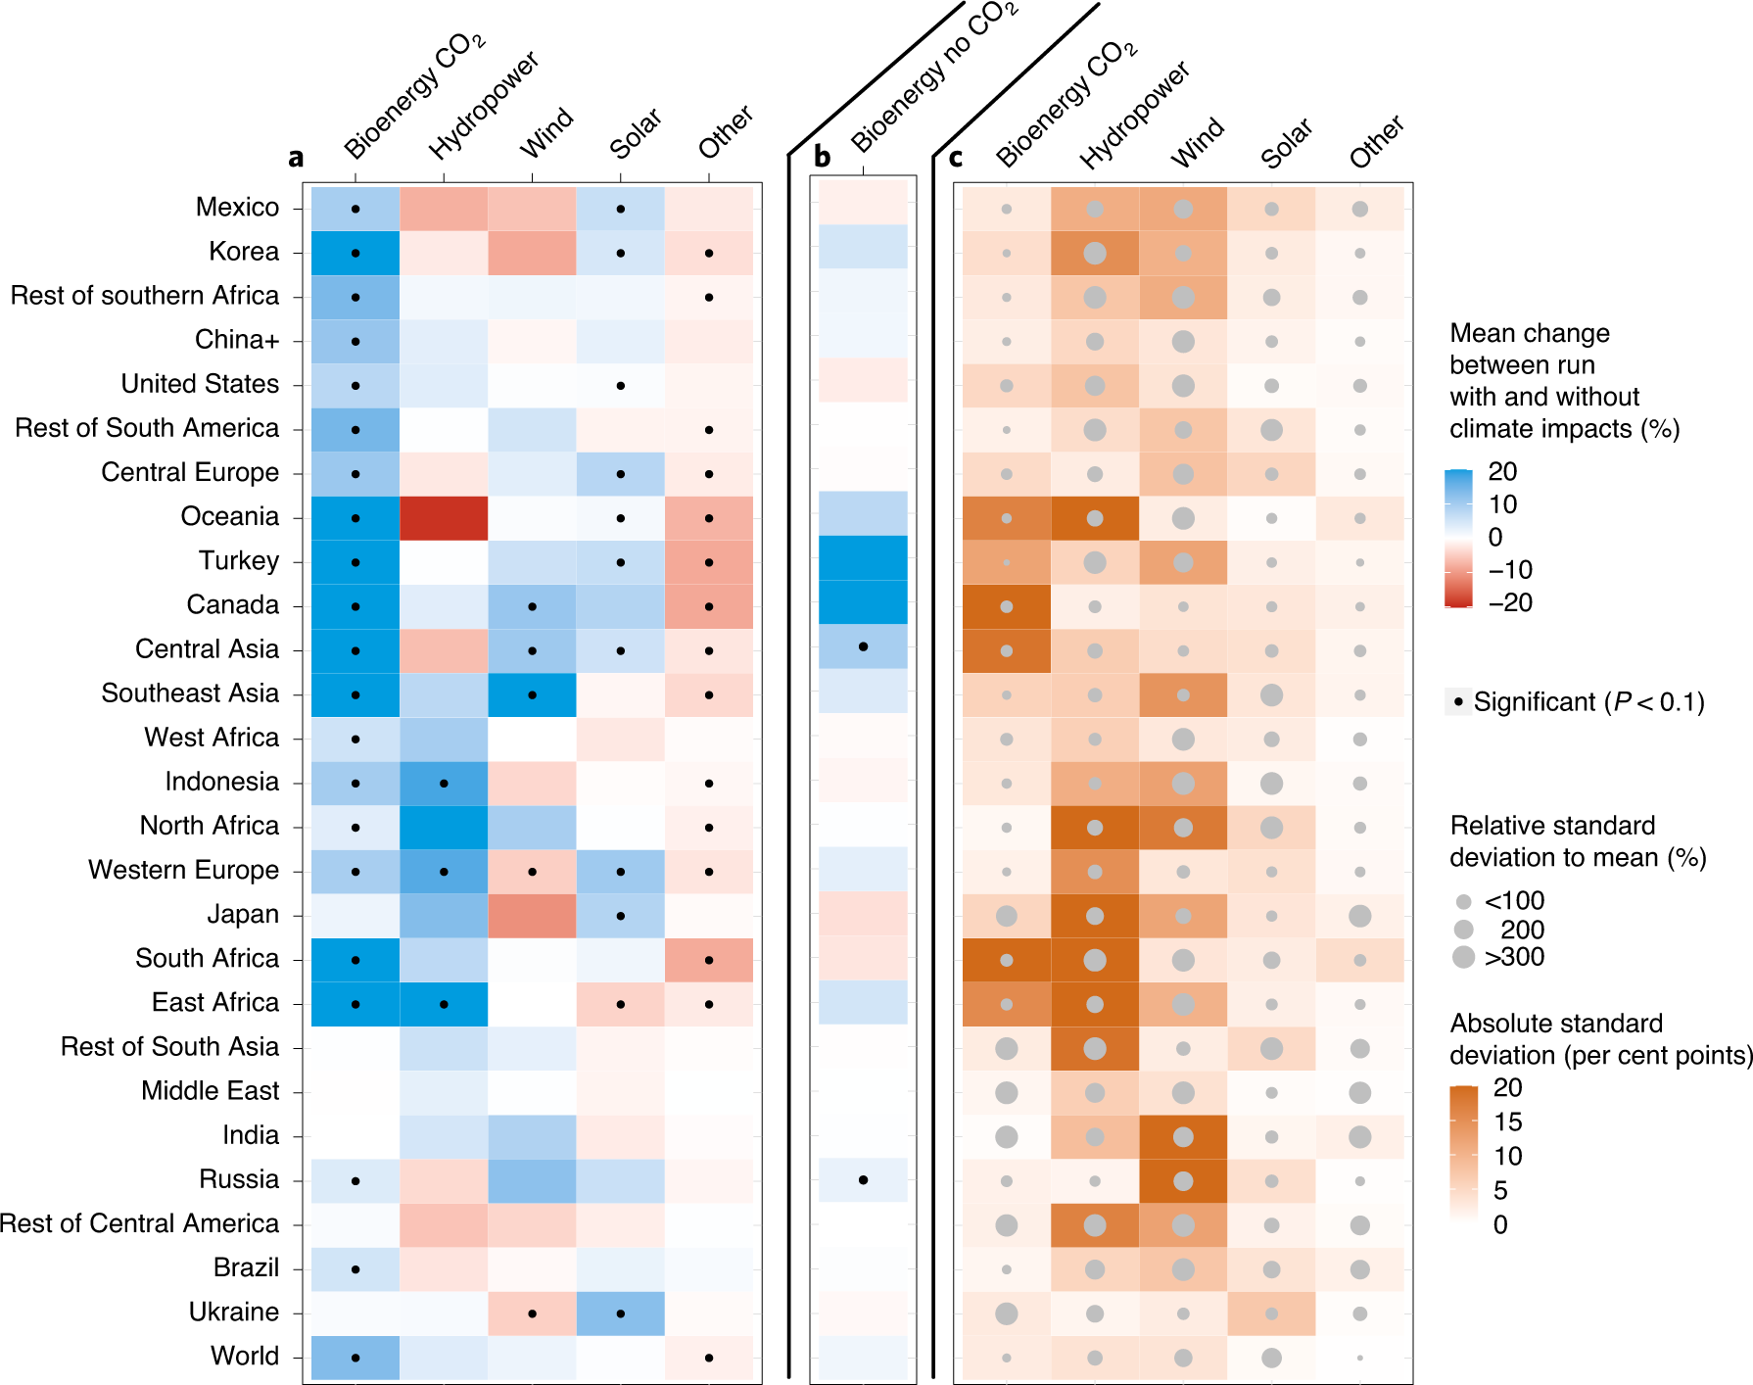
Climate Change Impacts on Renewable Energy Supply
https://www.nature.com/articles/s41558-020-00949-9
Notes:
a–c, Comparison of SSP2-RCP6.0 scenario (without climate impacts on renewables) and SSP2-RCP6.0-CI (with climate impacts on renewables): multi-model mean change (over GCMs) of the cumulative primary energy supply in the 2070–2100 period per technology with CO₂ fertilization for bioenergy (a), mean specific climate impact on bioenergy without CO₂ fertilization (same data as used in Supplementary Fig. 7b) (b) and absolute standard deviation (per cent, shown in orange gradient) and the relative standard deviation (shown by grey dot size) over the GCMs of the data shown in a (c) a. Regions and technologies are ordered to form visual clusters of colour. China+ includes Taiwan. Black dots in a,b mark regions where Wilcoxon statistical test shows significant (P < 0.1) differences across GCMs, compared with the historical period.

Slide 31
The approach we take in GCAM for climate impacts (e.g., for water supply and hydropower)
GCAM
We use an ESM that is assumed to have a similar forcing (e.g., RCP) to GCAM’s simple climate model
Simple climate model
Land
Earth System Model (ESM)
Demand
Supply
Crop Model
Energy
Demand
Supply
hydropower
Water
External Global Hydrology Model
Demand
Supply
Runoff
(renewable supply)

Slide 32
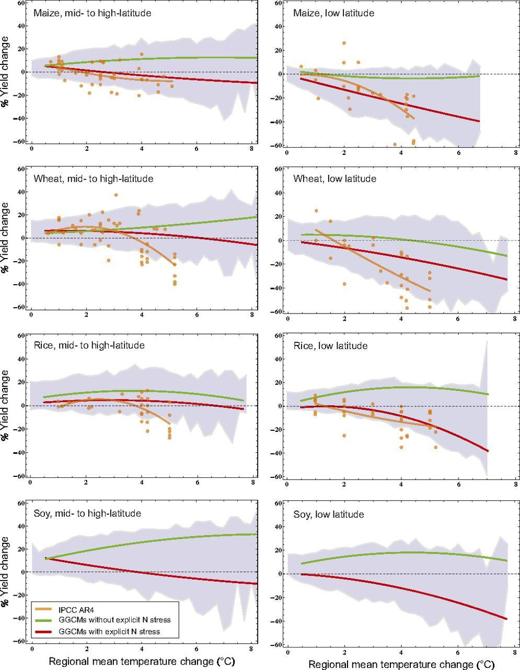
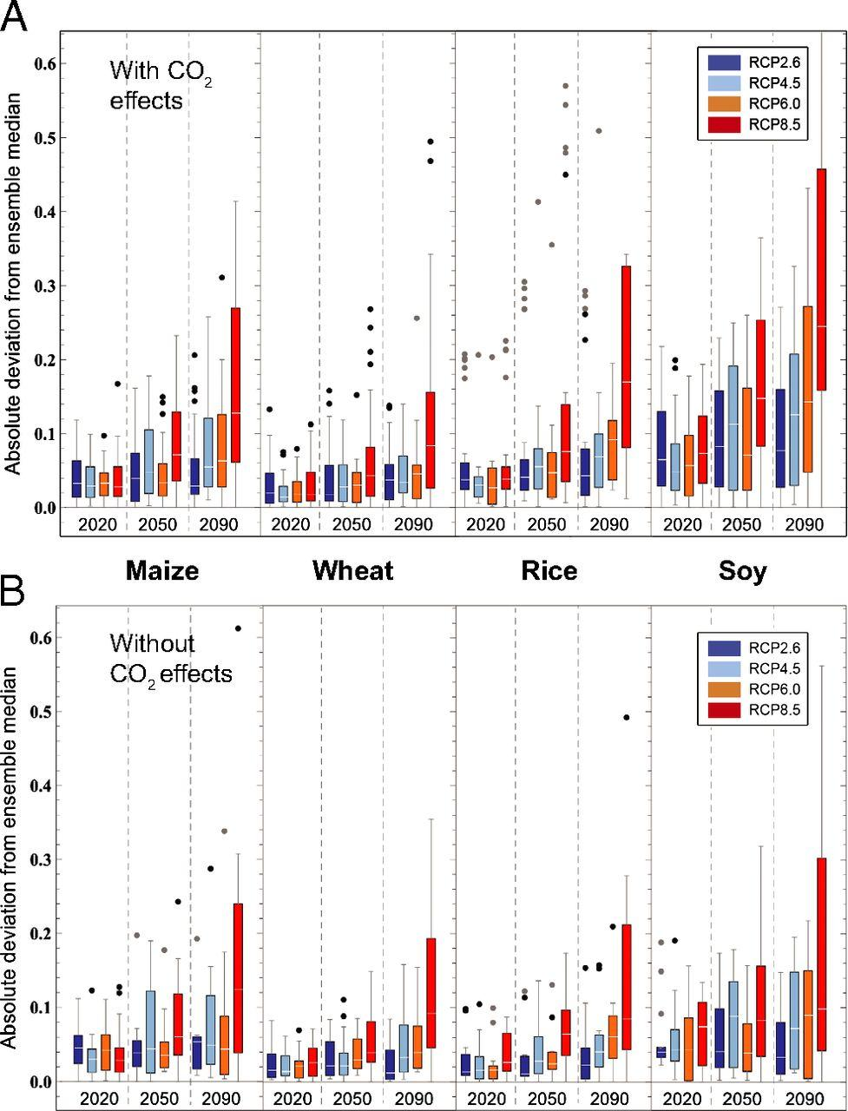
Climate Impacts on Agricultural Yields
Source: Rosenzweig et al. (2014), PNAS

Slide 33
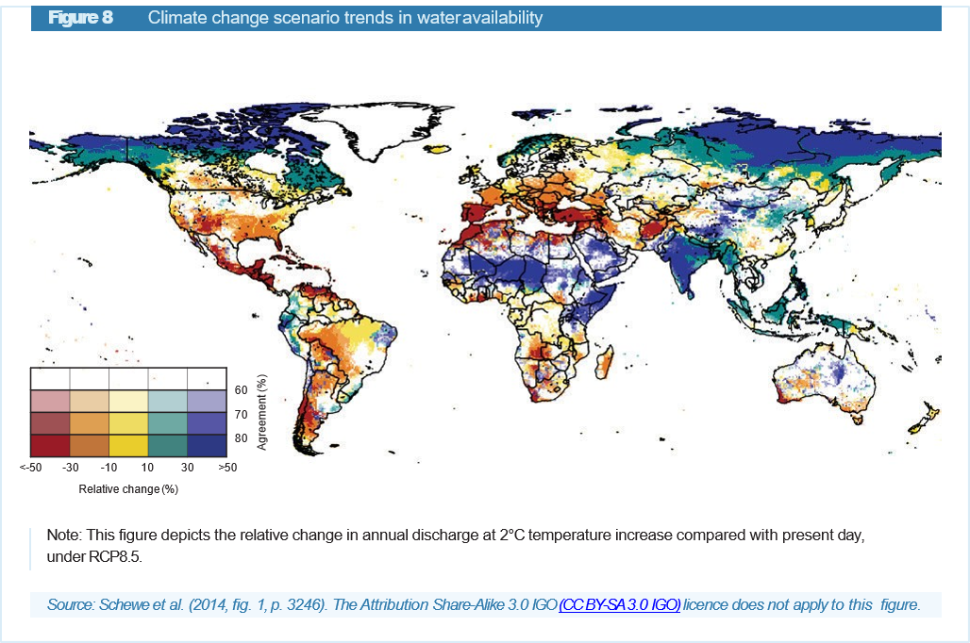
How will Climate Change Impact Water Supply?
An accelerated water cycle will increase rainfall and thus renewable freshwater flux. But there will be winners and losers. Some regions will see more and some less water on average.
There is huge uncertainty—Earth System Models (ESMs) only agree for about 1/3 of land area.
This is a big challenge for IAMs, because they have not been built to consider extreme events

Slide 34
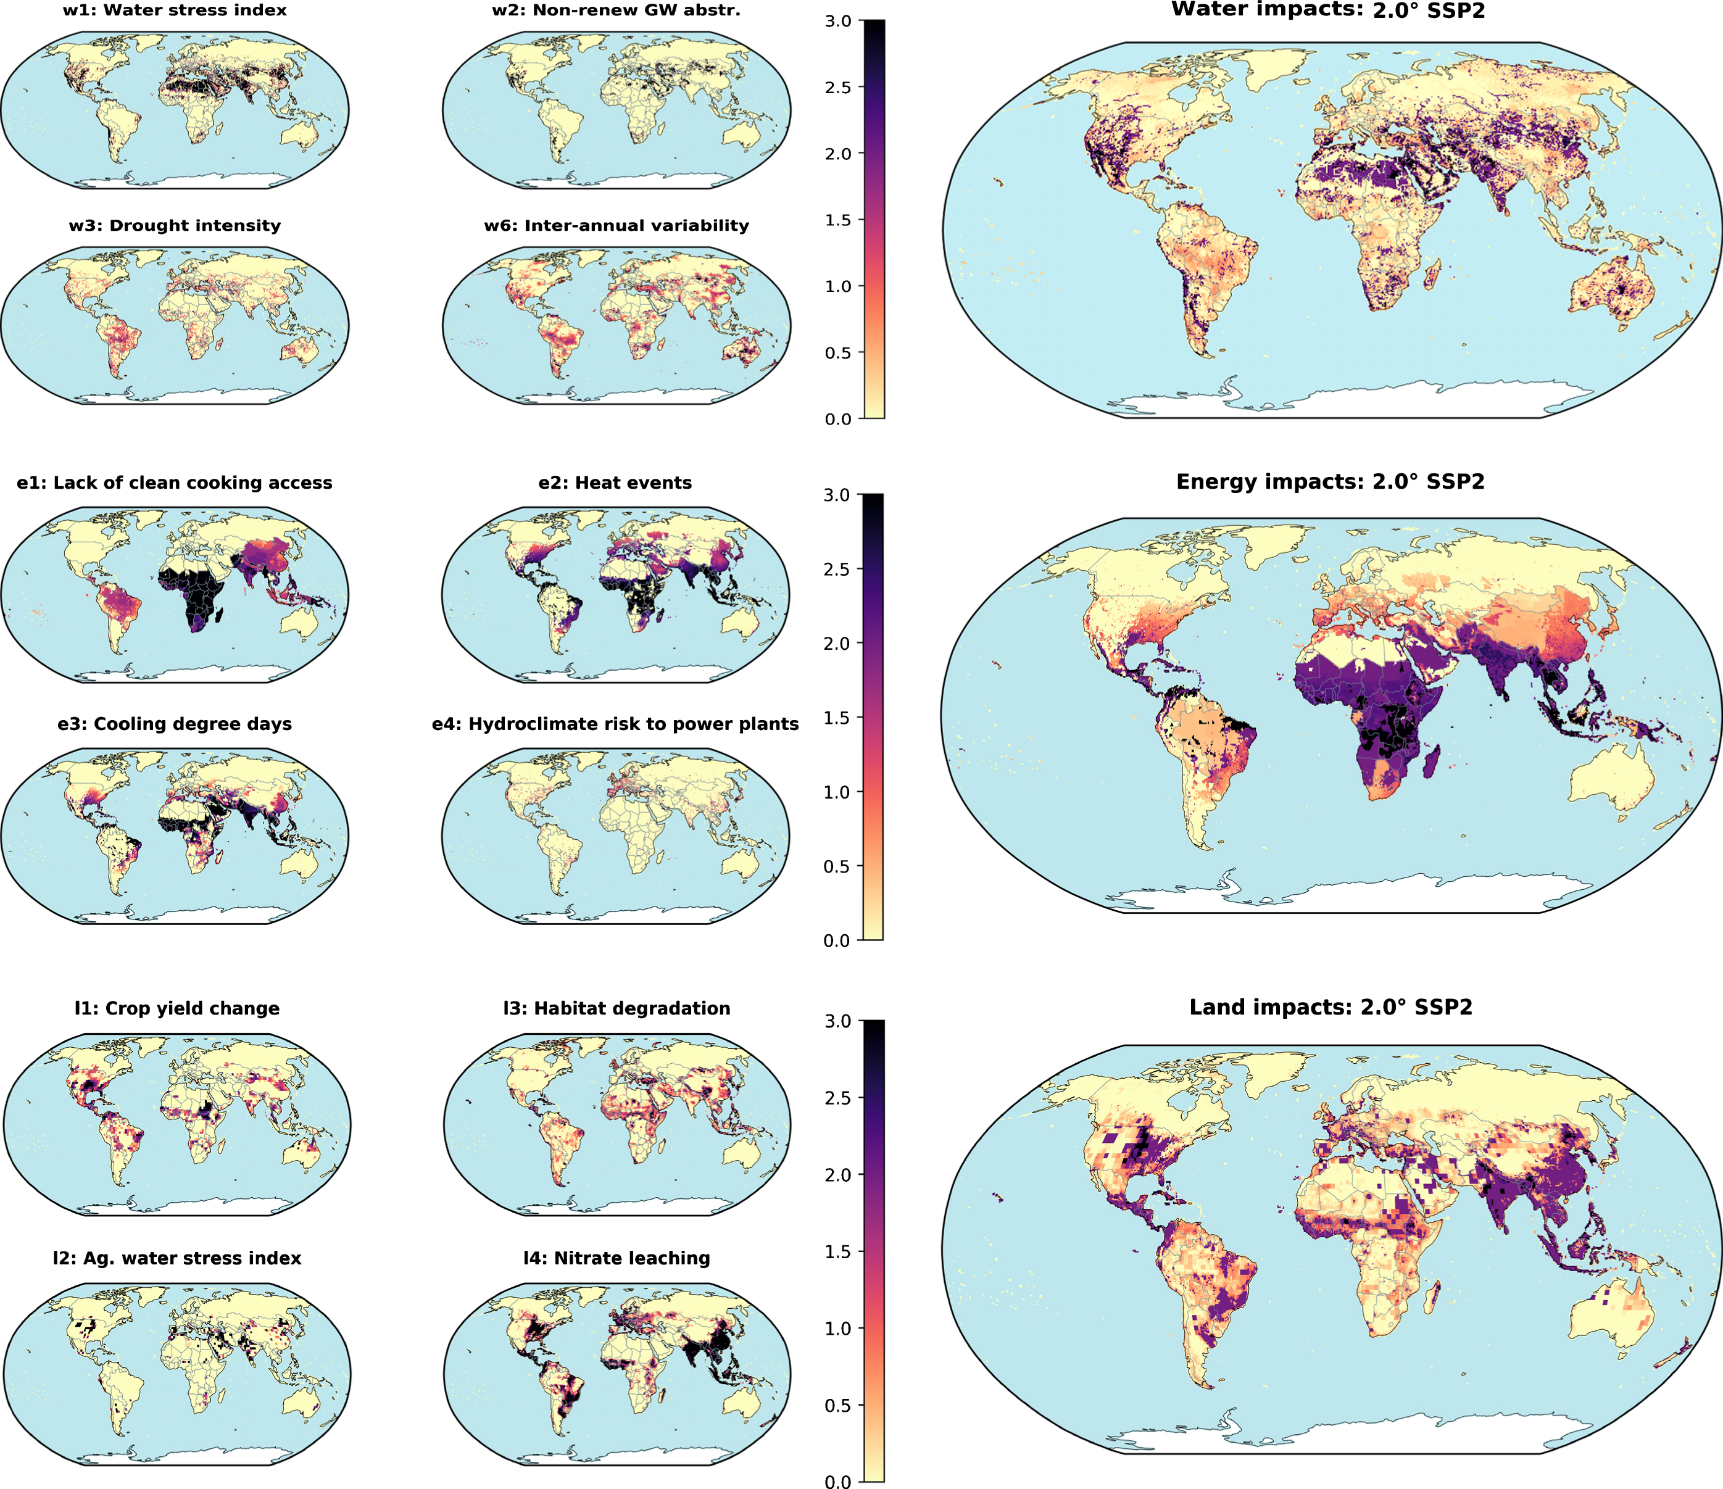
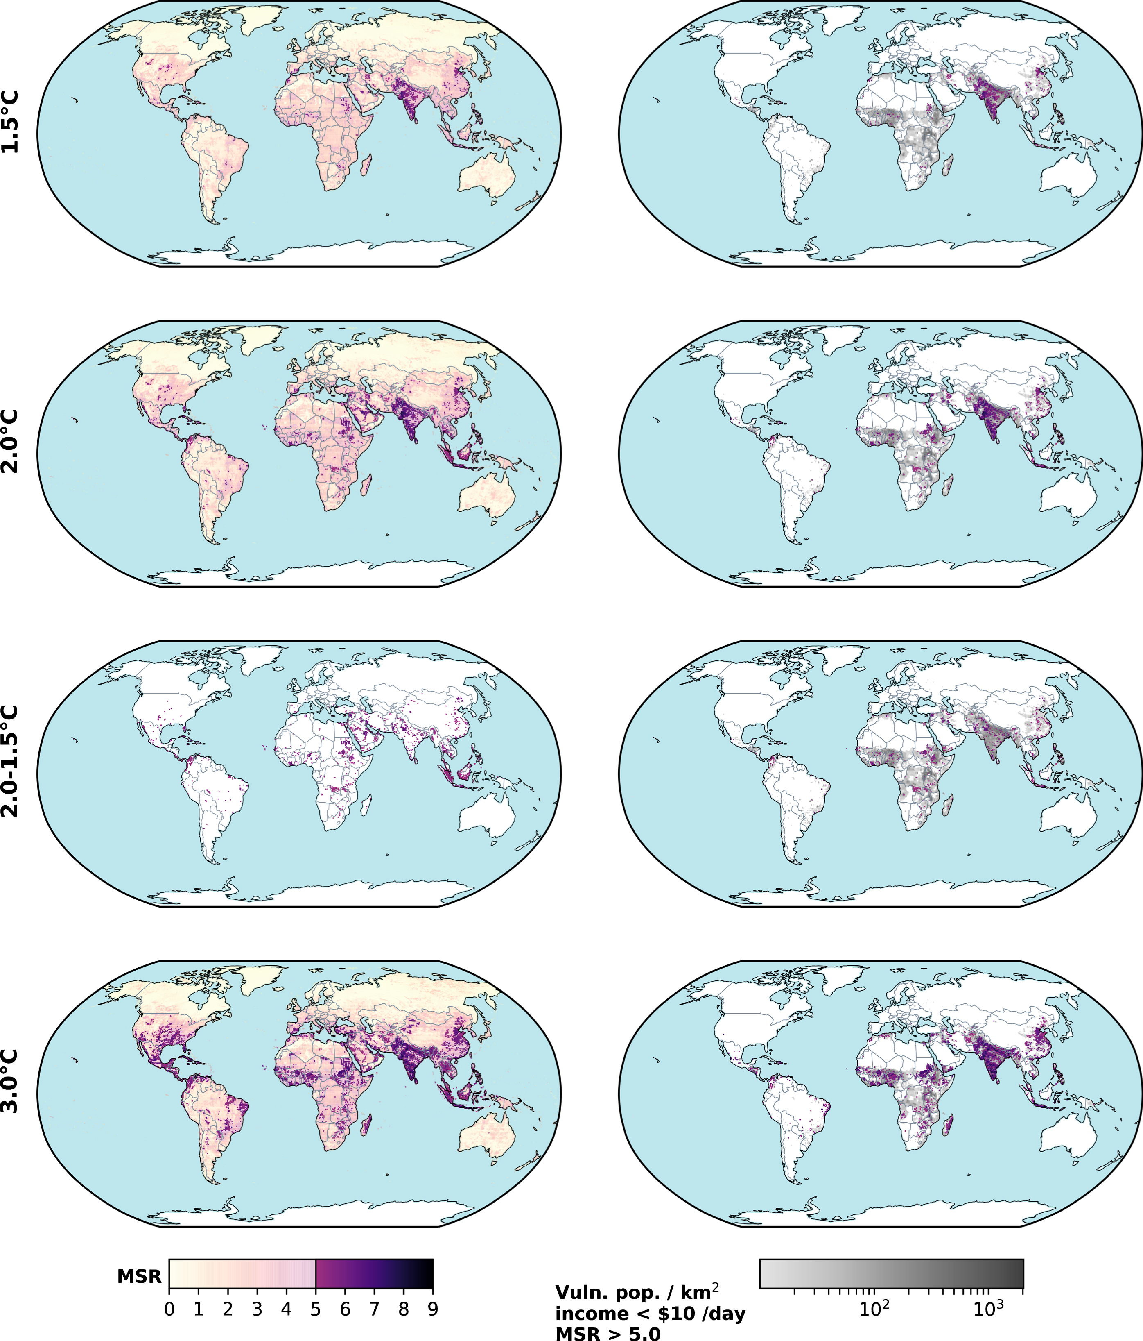
Vulnerability to Climate Impacts
Impact Risks
Vulnerable Populations
Byers et al. 2018 (ERL) https://iopscience.iop.org/article/10.1088/1748-9326/aabf45/meta
Notes:
(left) Figure 1. Sectoral score (0–3) maps for 2 °C GMT warming scenario. In the left column the individual indicators are shown, in the right column are the sectoral scores. Note that only four of the six water indicators are shown. Full indicator and sectoral exposure data available in SI tables S7–8.
(right) Figure 2. Multi-sector risk maps for 1.5 °C, 2 °C and 3 °C climates. Left column shows the full score range 0–9 (with transparency) and multi-sector risk score, MSR ≥ 5.0, in full colour. Right column greyscale underlay is the SSP2 2050 vulnerable populations, with the MSR ≥ 5.0 overlaid (only pixels ≥10 vulnerable persons km⁻²), indicating the concentrations of exposed and vulnerable populations (E&V). Moderate and high multi-sector impacts are prevalent where vulnerable people live, predominantly in South Asia at 1.5 °C, but spreading to sub-Saharan Africa, the Middle East and East Asia at higher warming.

Slide 35
Summary

Slide 36
Summary
IAMs consider energy, water, land, socioeconomics, and climate in a single, consistent economic framework
IAMs do not include all possible nexus interactions, but they have evolved to include many important interactions
GCAM accounts for climate feedbacks with water, energy, and land via one-way input files, rather than two-way feedbacks (for now)
Carefully consider a given IAMs internal dynamics in crafting research questions

Slide 37
Example Case Studies

Slide 38
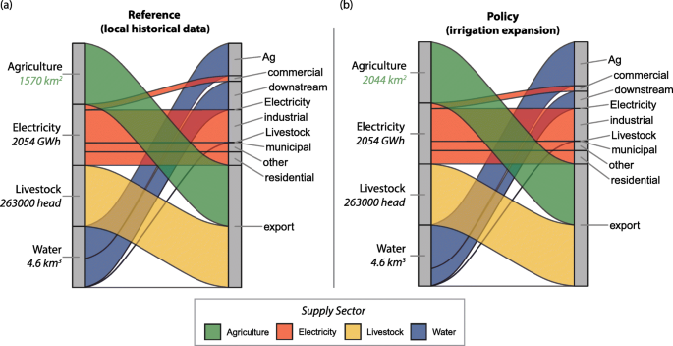
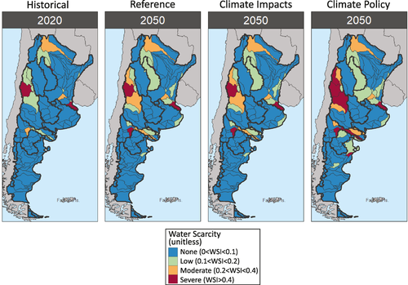
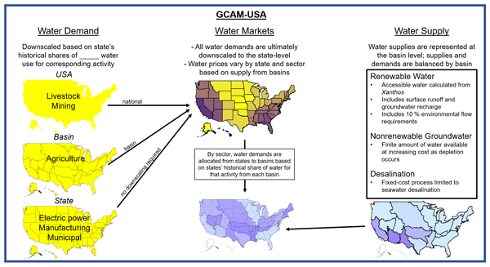
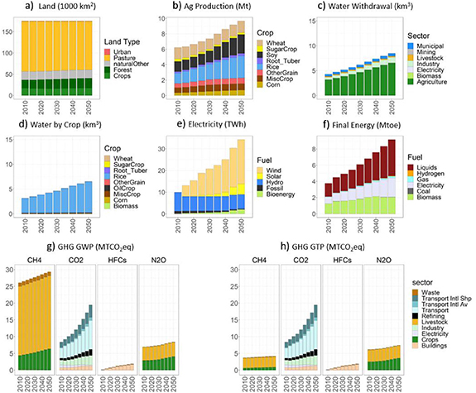
Some Nexus Case-study Papers
Integrated energy-water-land nexus planning in the Colorado River Basin (Argentina) – (Wild et al. 2021)
The Implications of Global Change for the Co-Evolution of Argentina's Integrated Energy-Water-Land Systems – (Wild et al. 2021)
GCAM-USA v5.3_water_dispatch: integrated modeling of subnational US energy, water, and land systems within a global framework – (Binsted et al. 2022)
Integrated energy-water-land nexus planning to guide national policy: an example from Uruguay – (Khan et al. 2020)

Slide 39
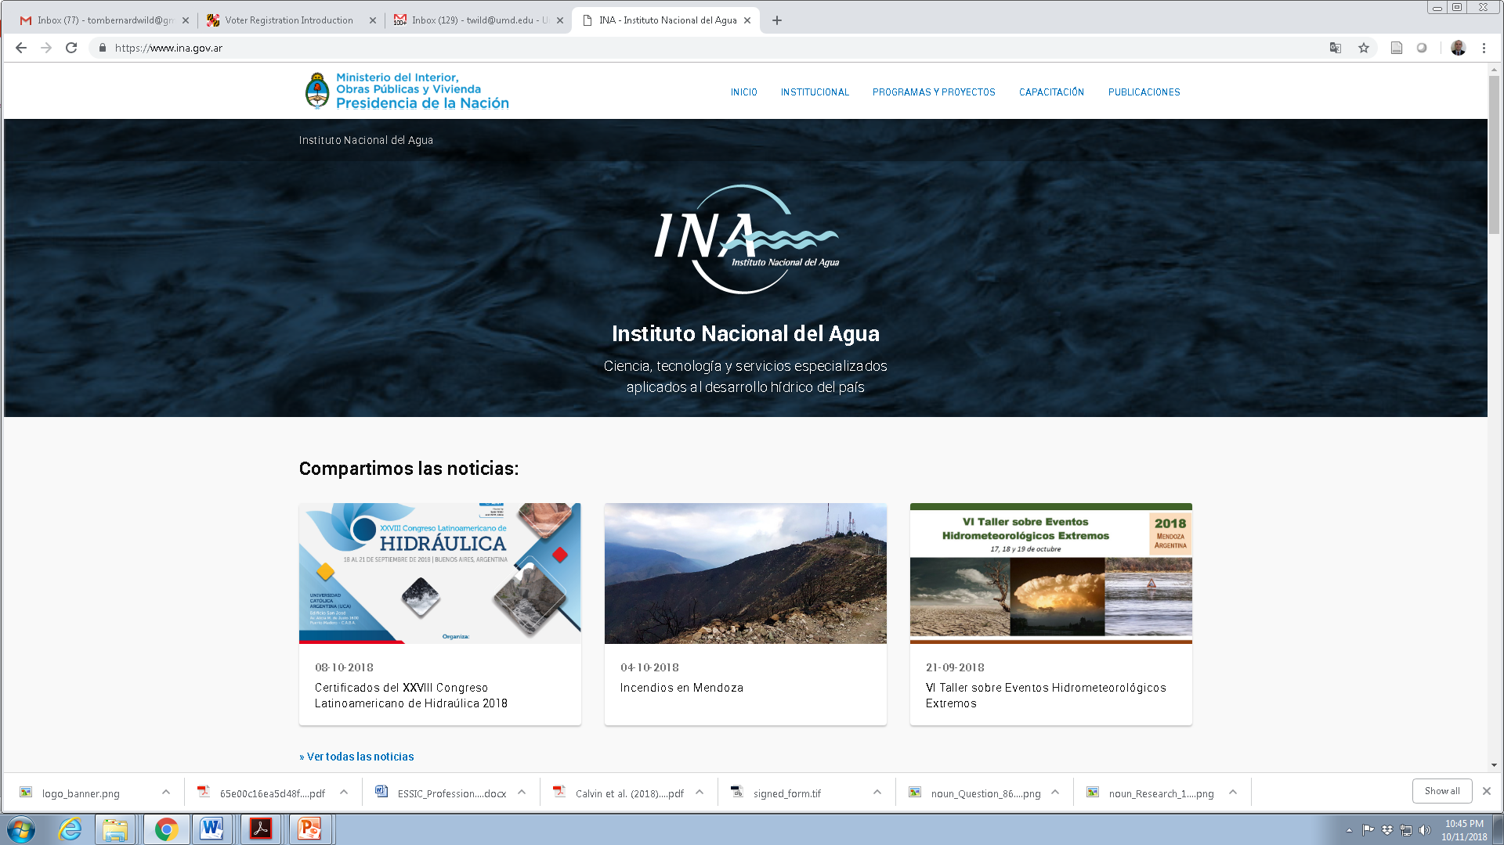





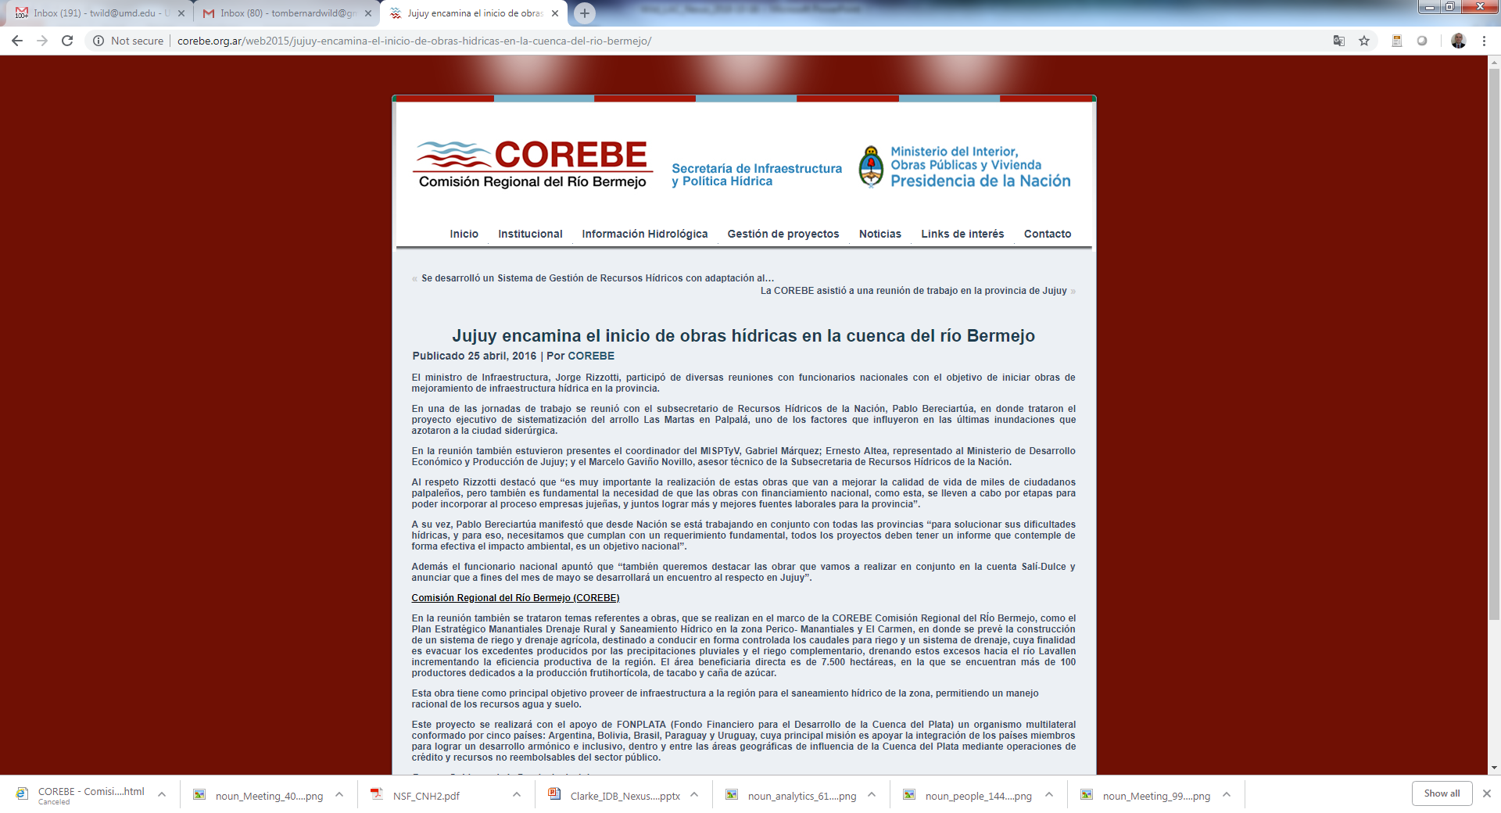
Exploring Energy-Water-Land Nexus in Latin America
Exploring approaches to enhance energy-water-land nexus planning via pilot projects in Colombia, Uruguay, and Argentina with local collaborators.
Argentina
Colombia
Uruguay
Wild et al. (in review), Earth’s Future
Wild et al. (in revision), Reg. Env. Change
Wild et al. (in preparation), Environmental Research Letters
Khan et al. (2020), Environmental Research Letters

Slide 40
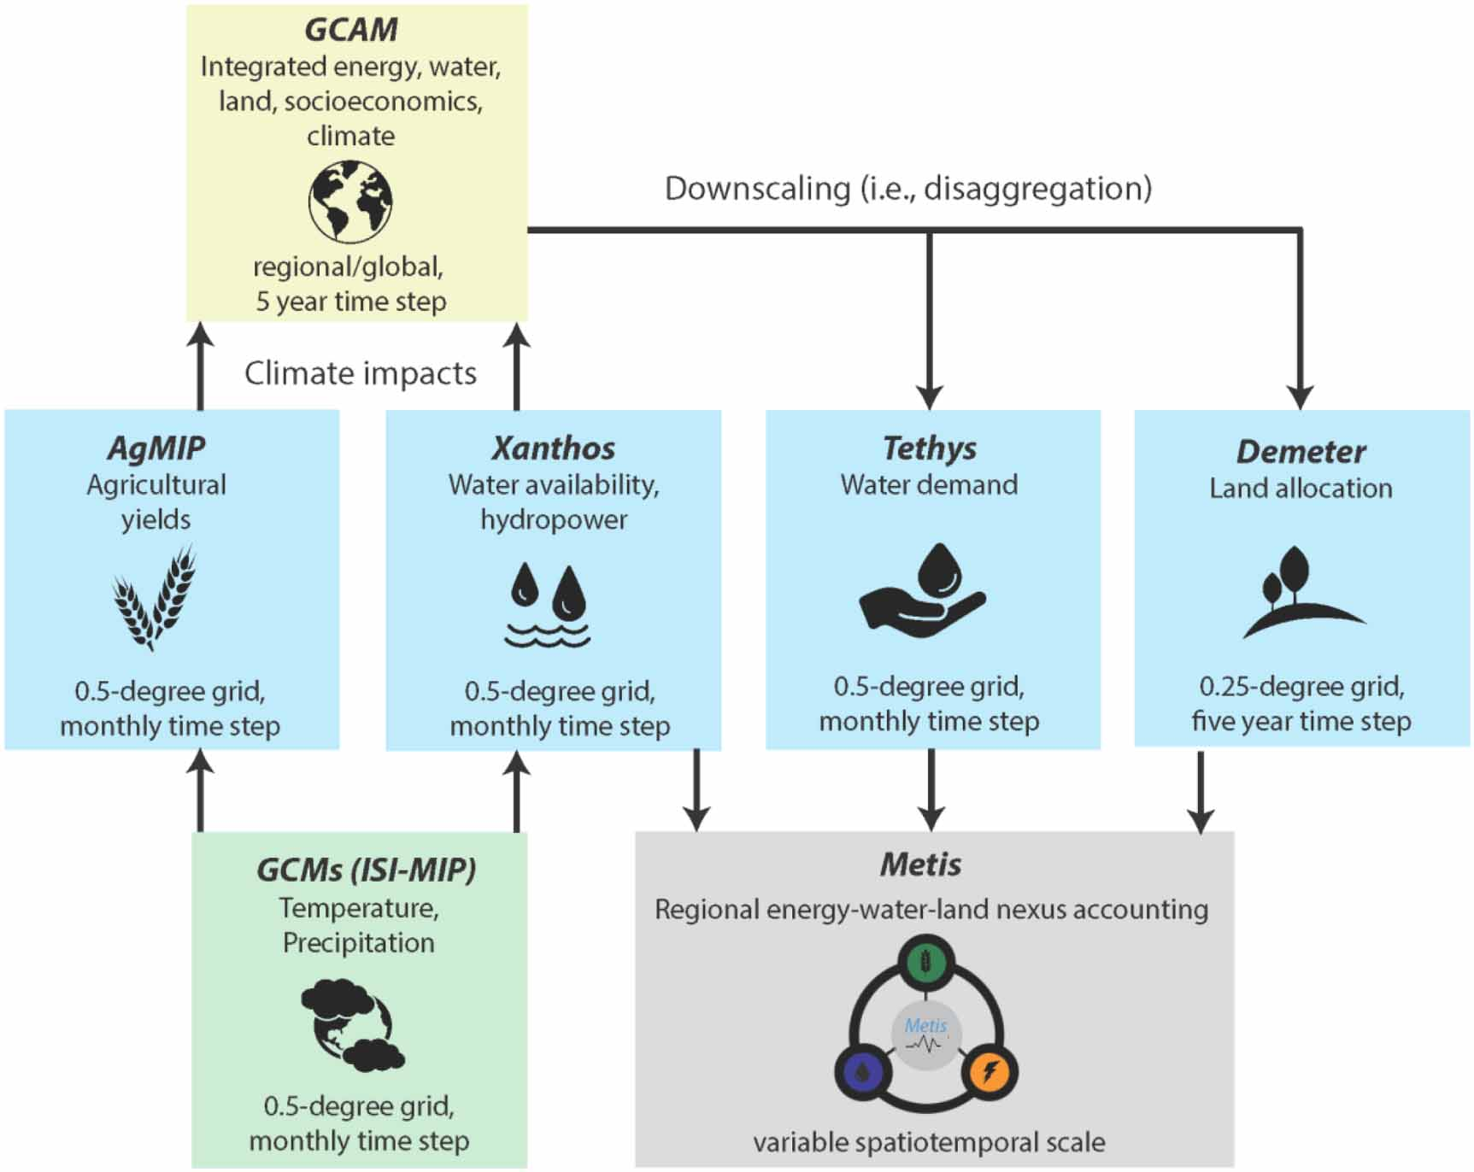
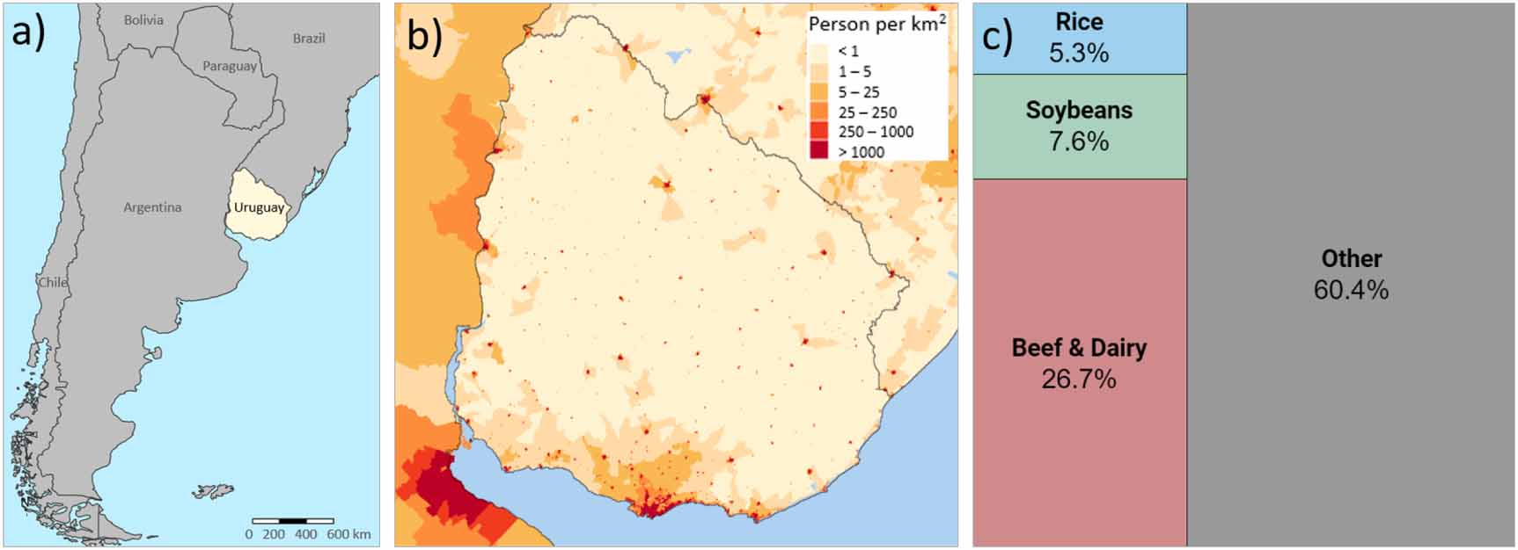
Integrated energy-water-land nexus planning to guide national policy: an example from Uruguay
Figure 1. (a) Location of Uruguay in Latin America, (b) Population density in Uruguay in 2015 [46], and (c) Percentage of Uruguay’s total export revenue in 2017 by selected sectors (Data from [5]).
Figure 2. Modeling framework used to analyze energy-water-land dynamics at relevant spatiotemporal scales in Uruguay.
https://iopscience.iop.org/article/10.1088/1748-9326/ab9389

Slide 41
Uruguay Nexus Case Study: Scenarios
Table 1. Summary of scenarios used in study.
Scenario | Description
Reference | Uses an agreed upon set of assumptions for key drivers such as population and GDP growth in Uruguay. For the rest of the world, the scenario is roughly consistent with the Shared Socioeconomic Pathway 2 (SSP2). The SSP2 scenario represents costs, prices, elasticities and preferences in a “middle-of-the-road” narrative in which social, economic, and technological trends do not shift markedly from historical patterns [64–66]. The Climate and policy scenarios below employ the same basic socioeconomic assumptions built into the Reference scenario
Climate | Evaluates the impacts of climate change on three key parameters: hydro-electric power production, agricultural yields, and water availability (i.e. runoff) for five bias-corrected Global Climate Models (GCMs) from the Inter-Sectoral Impacts Model Intercomparison Project (ISI-MIP) [67] and four Representative Concentration Pathways (RCP) [68]. This range of models and climate forcing scenarios are used to explore uncertainty surrounding future climate conditions. From among this range of Climate scenarios, we selected one to be used in the Climate scenario, which consists of the GFDL GCM run with the RCP8.5 climate forcing trajectory. This results in the following outcomes, which are fed into GCAM:Hydropower increases by 20% by 2050 from the Reference scenario Runoff increases by 3% by 2050 from the Reference scenario Irrigated Soy yield increases by about 4% by 2050 from the Reference scenario within Uruguay, though significant changes also take place in global markets Irrigated Rice yield fluctuates between ± 4% by 2050 from the Reference scenario within Uruguay, though significant changes also take place in global markets
Beef | Increases the productivity by weight of beef production, and decreases the CH₄ and N₂O emissions intensity of beef production in line with the National Adaptation Plan for Agriculture (NAP-Ag) [8, 69] and the Nationally Determined Contributions (NDCs) of emissions outlined in Uruguay’s commitment as part of the Paris Agreement [70].Increase production (kg beef/kg feed) by 40% by 2030 relative to 2015 values, then hold this production efficiency constant through 2050 Decrease emission intensity (emissions/kg) of CH₄ by 40% by 2030 relative to 1990 values, then hold this production efficiency constant through 2050 Decrease emission intensity (emissions/kg) of N₂O by 40% by 2030 relative to 1990 values, then this production efficiency hold constant through 2050
Soy | Increases irrigated area of soybean crops to gain higher yields in line with the National Plan to Improve Irrigated Agriculture [71, 72].Increases share of irrigated soybean area as compared to rainfed soybean area, so that irrigated soybean area is 600% of the 2015 values in 2030. Shares of irrigated vs rainfed soybean area are then held constant through 2050
Rice | Improves the yield of rice based on recommended best-practices from Uruguay’s Ministry of Agriculture to close the national rice yield gap [73, 74].Adjusts annual rice yield growth to increase yields (tons/ha) by 20% by 2030 relative to 2015 values, and then maintain reference growth in yields through 2050

Slide 42

Uruguay Nexus Case Study: Reference
Figure 3. Nexus overview of the Reference scenario. (a) Land-use (1000 km²) (b) Agricultural Production (Mt) (c) Water withdrawals (km³) (d) Water use by Crop (km³) (e) Electricity generation (TWh) (f) Final Energy (Mtoe) (g) GHG emissions GWP (MTCO₂eq) by gas and sector (h) GHG emissions GTP (MTCO₂eq) by gas and sector (HFCs = Hydrofluorocarbons).
https://iopscience.iop.org/article/10.1088/1748-9326/ab9389

Slide 43
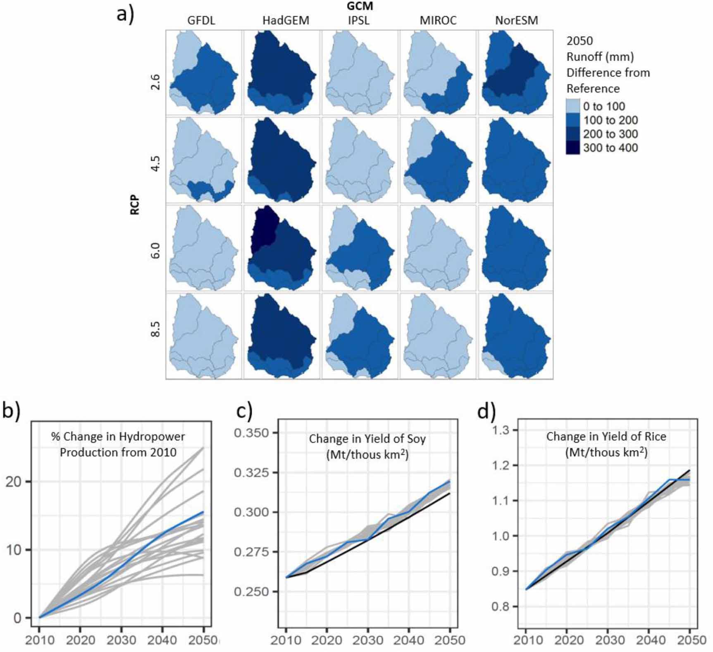
Uruguay Nexus Case Study: Impacts
Figure 5. Climate scenario inputs. Projected changes for combinations of five different GCMs and four RCPs for (a) absolute difference between 2050 and reference runoff (mm) (b) % change in hydropower (c) change in yield of soy (Million tons per thousand square kilometers) (d) change in yield of rice (Million tons per thousand square kilometers). For illustration: black lines correspond to the Reference scenario, blue lines correspond to the chosen climate scenario for this study (GFDL_RCP8p5), while the grey lines show all other GCM/RCP combinations. Note: 1 Mt/thous km² = 10 ton/hectare.
https://iopscience.iop.org/article/10.1088/1748-9326/ab9389

Slide 44
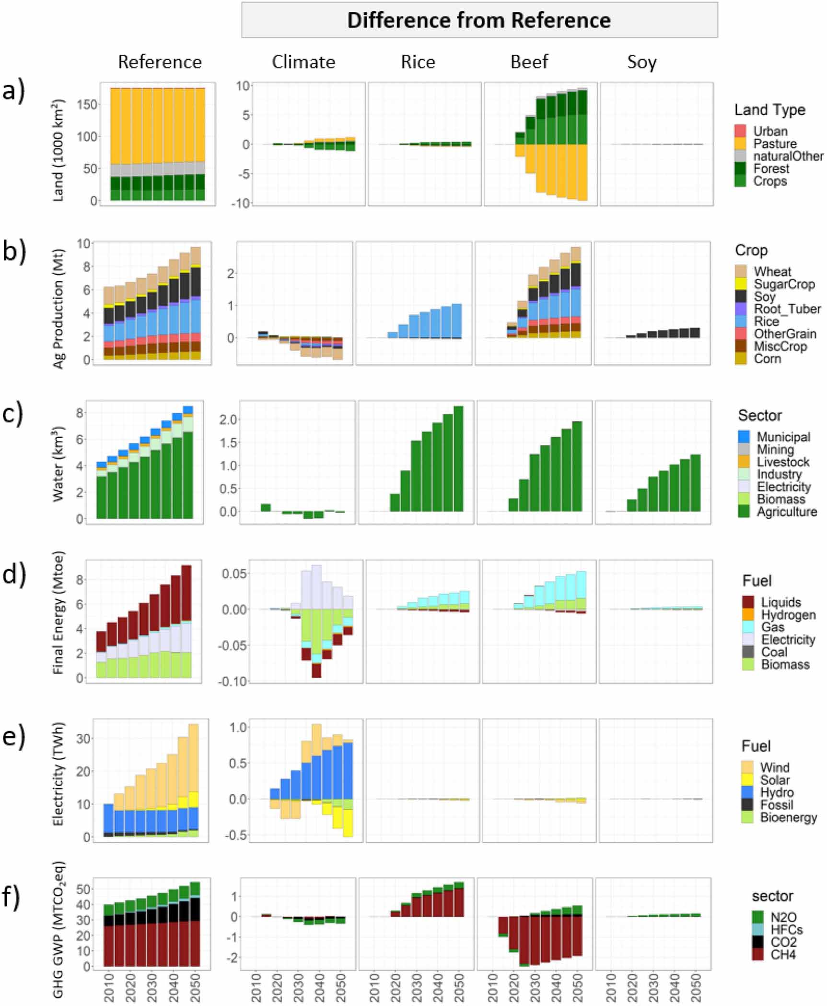
Uruguay Nexus Case Study: Nexus Analysis
Nexus insight 1: Improving beef production efficiency and emissions intensity could indirectly impact land, crops, and water.
Nexus Insight 2: Increased emissions from rice yields could offset decreased emissions from enhancing beef production efficiency and emissions intensity.
Nexus insight 3: Soy irrigation expansion policy is the least disruptive to EWL systems.
Nexus insight 4: The human dimension of change may exceed climate change with respect to EWL nexus impacts.
Figure 7. Nexus comparison across scenarios. First column shows sub-sector details for the Reference scenario, and the second through fifth columns show the differences between the Reference scenario and the Climate, Rice, Beef, and Soy scenarios, respectively. (a) Land allocation (1000 km²), (b) Agricultural Production (Mt), (c) Water withdrawals (km³), (d) Final energy (Mtoe), (e) Electricity (TWh), and (f) GHG emissions GWP (MTCO₂eq).
https://iopscience.iop.org/article/10.1088/1748-9326/ab9389

